Slide 1

RiskyProject
Project Risk Analysis
and
Project Risk Management Software Suite

Slide 2
What Is RiskyProject?
RiskyProject is Windows-based project risk management software.
Project Scheduling
Risk Register
Quantitative risk analysis using Monte Carlo simulations
Project performance measurement
Risky Project gives you a simple answer to a common question: What will happen to your project if certain risks occur?

Slide 3
The Project Management Problem
Projects consistently fail to meet:
Budget
Schedule
Quality
Safety
Technology
Other measures

Slide 4
The Project Management Problem
Reasons
  Human psychological limits
  Inadequate training
  Poor processes
  others

Slide 5
The Project Management Problem
Key Project Management Issues
  How to estimate project duration or cost?
  What are the most critical risks and how to mitigate them?
  How to measure project performance?
  How to make an informed decision about future course of the project?

Slide 6
The RiskyProject Solution
Project risk management made simple
RiskyProject is consistent with PMI PMBOK. Risky Project supports the full project risk management process.
RiskyProject is very easy to use. RiskyProject is uses a scheduling interface similar to other project popular project management tools.
RiskyProject has low implementation and support costs. Compared with the comparative products, RiskyProject provides unmatched value

Slide 7
The RiskyProject Solution
Project risk management for Project Managers
Provide state of art quantitative project risk management tools
Low cost
Ease of implementation
Limited initial training required
Scalable

Slide 8
Key RiskyProject Features
Full scheduling engine with costs and resources
Full risk register that links to project schedules
Quantitative and qualitative analysis
Project control with risks and uncertainties
Integration with Microsoft Project, Primavera, or other project management software
Analysis of critical risk events, which need to be mitigated first
Product lifecycle management
Probabilistic and conditional branching
Managing mitigation and response plans
“What if “ analysis
Advanced reporting tools
Multiple statistical distributions and distribution fitting
… and more

Slide 9
RiskyProject Workflow
RiskyProject uses common PM artifacts
WBS
Resources
Costs
Risk Register or Risk Lists

Slide 10
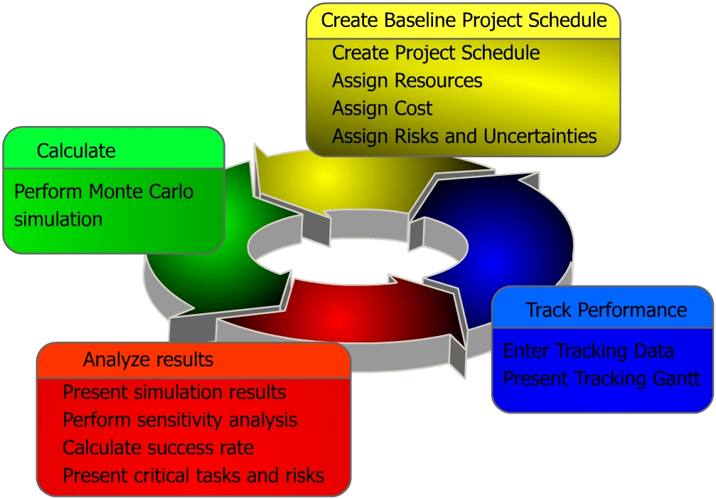
RiskyProject Workflow
RiskyProject’s workflow is compatible with PMI, Prince II, and other risk management processes

Slide 11
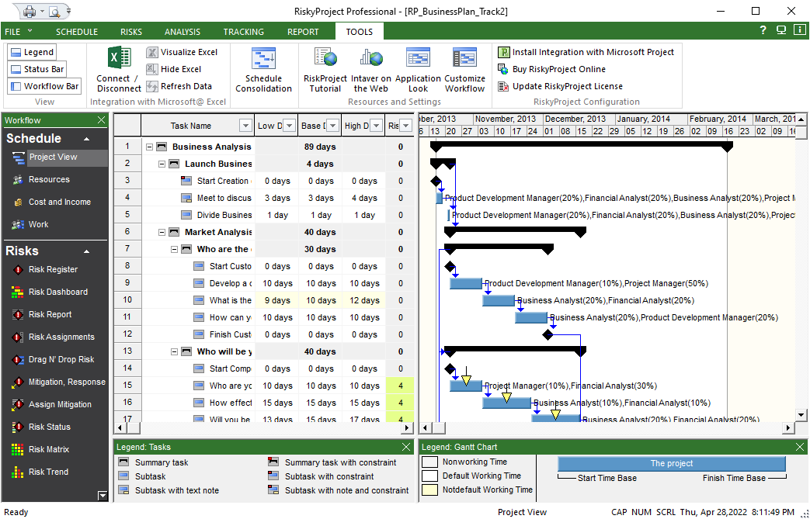
Define Project Schedule
Enter resources, cost and income for each task
You may also import project schedules from other scheduling tools, such as Microsoft Project or Oracle Primavera.
Enter complete WBS, as it is done in other project management software

Slide 12
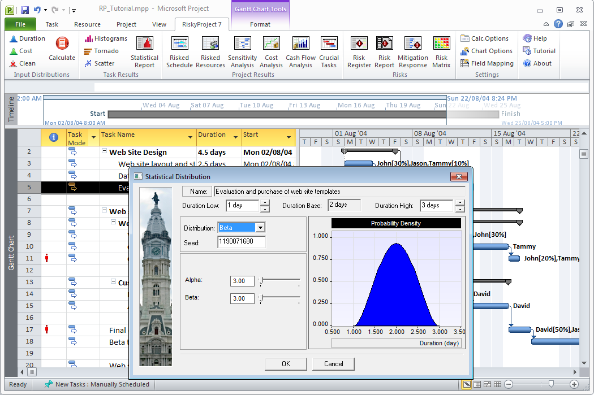
Integration with Scheduling Software
RiskyProject’s Add –in installed on the Microsoft Project ribbon allows users move projects
seamlessly into RiskyProject
RiskyProject Add-in for Microsoft Project
Microsoft Project
Defining Statistical Distribution in Microsoft Project
RiskyProject can import schedules from Oracle Primavera and other project management software.

Slide 13
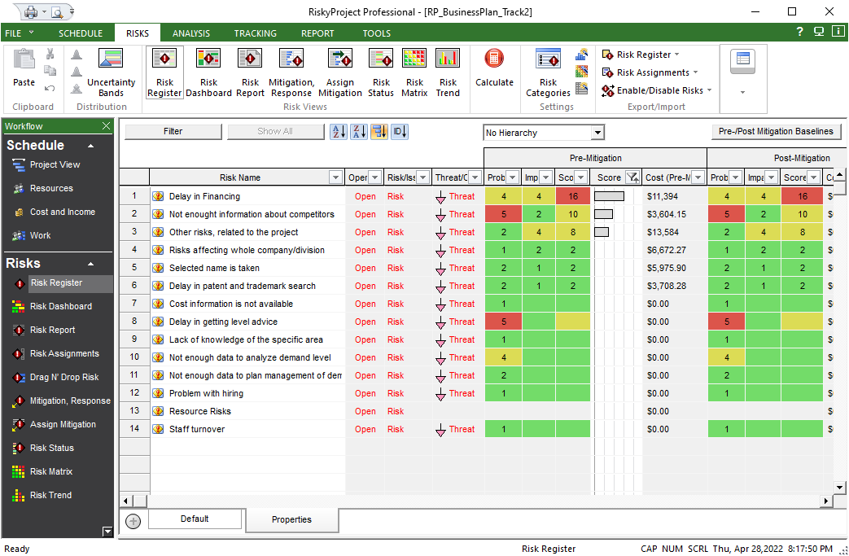
Risk Register
Risk register view
Separate opened and closed risks, risk, issues, lessons learned
Separate threats or opportunities
Pre mitigation
Probability, Impact, and Score
Post mitigation
Probability, Impact, and Score

Slide 14
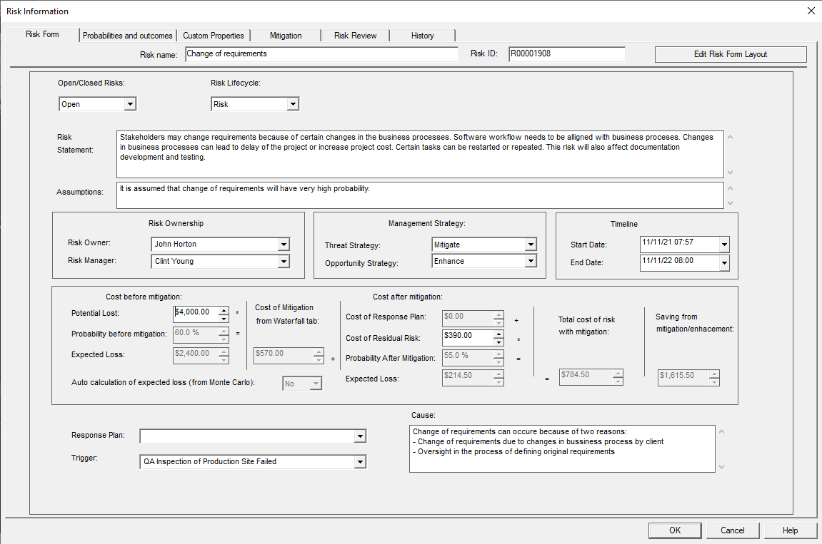
Customizable Risk Form
Double-click on a risk to view or modify Risk Information
Edit Risk Form Layout: You can define any risk properties
Risk description and status
Management Strategy and Risk Ownership
Cost of Risk
Risk Trigger and Response Plan

Slide 15
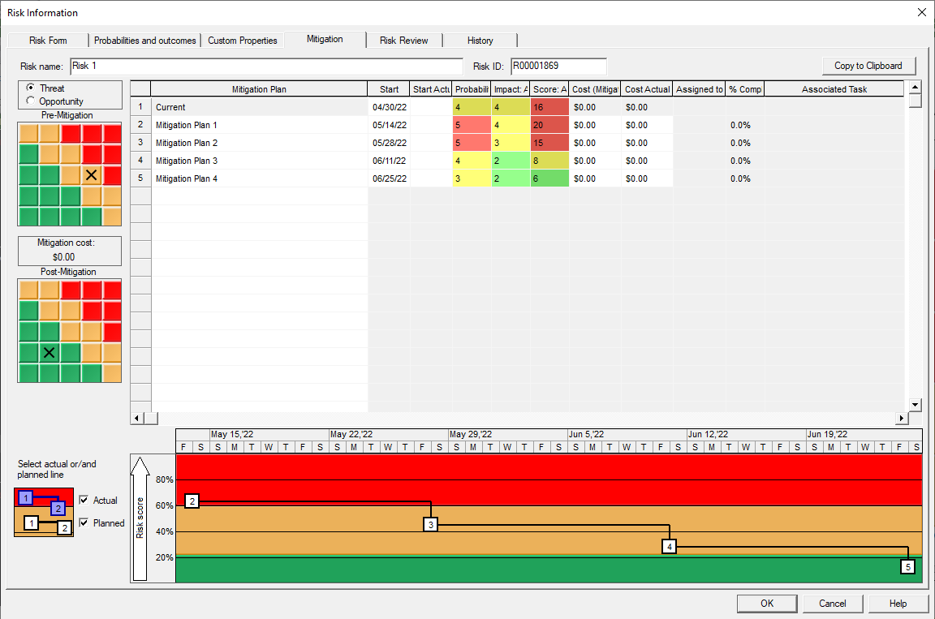
Mitigation Waterfall Chart
Track total cost, expected reductions in probability or impact and dates for mitigation plans
You can associate tasks on the project schedule with mitigation plans
Compare actual and planned mitigation efforts
Waterfall Chart: How risks are changing over time

Slide 16
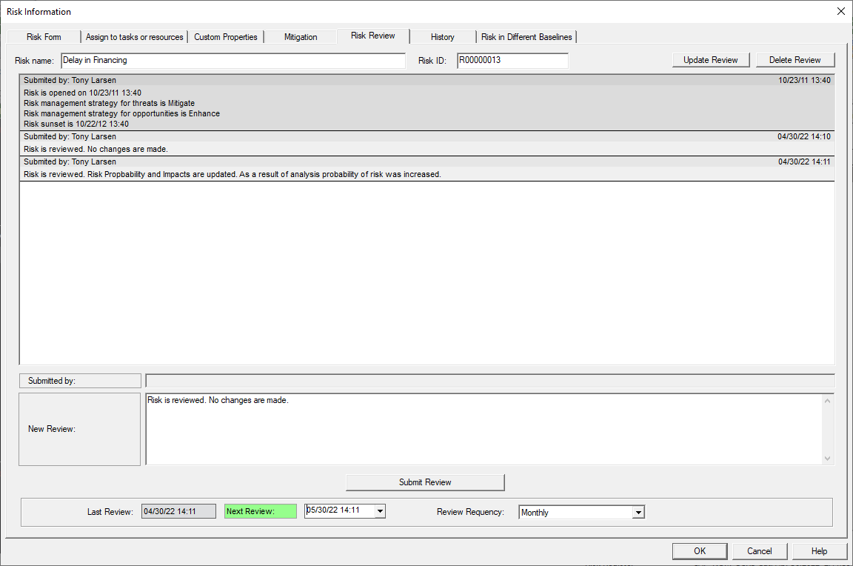
Risk Reviews and Risk History
All risk reviews with details can be saved and tracked in system
Risk History Log: All changes to risk properties, probabilities and impacts
Information about risk reviews
Next review timing

Slide 17
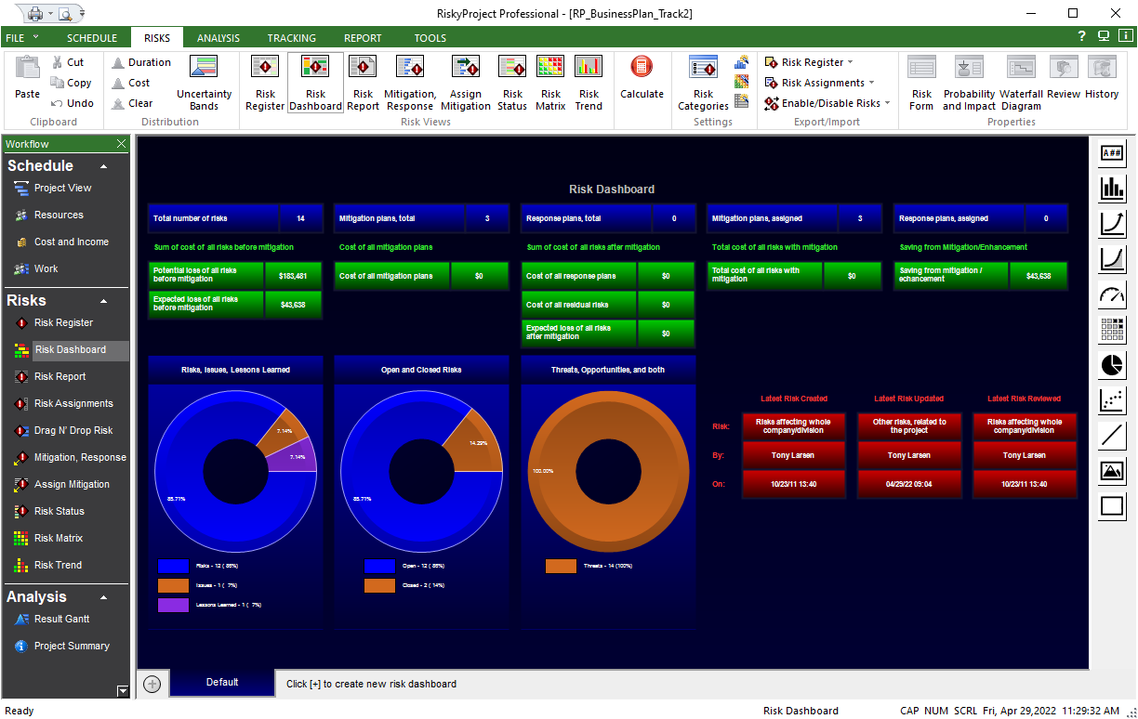
Risk Dashboard
Select different charts, graphs and indicators.
Draw and drop then on the dashboard
Create any number of tabs representing different dashboards

Slide 18
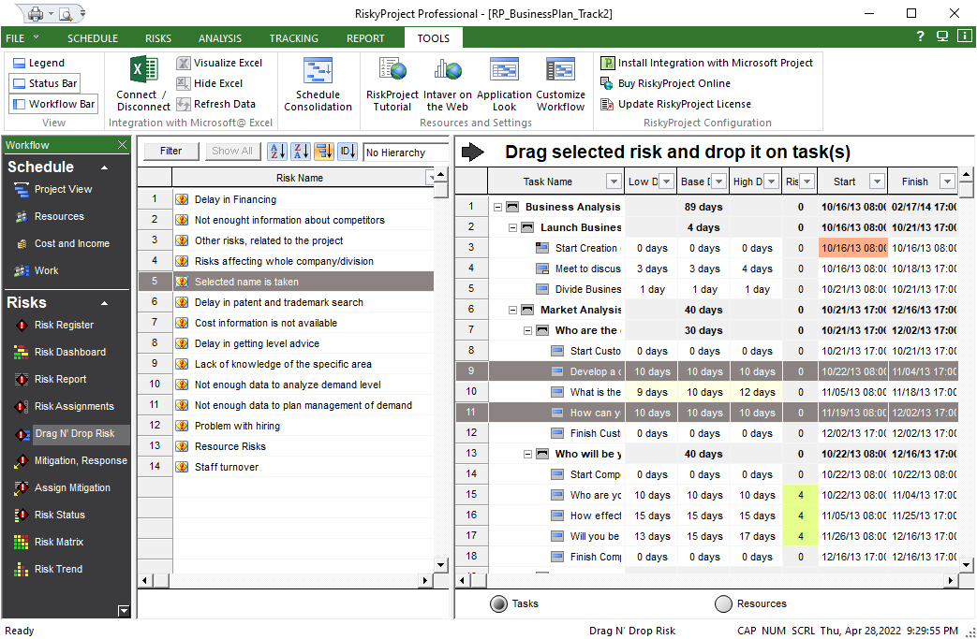
Assign Risks to Tasks and Resources
If project schedule is available, quantitative risk assessments is performed
Risks
Tasks
Drag and drop risk on particular task or group of tasks
Define risk chance, outcome and result. Risks can have mutually exclusive outcomes, different outcomes of the same risk

Slide 19
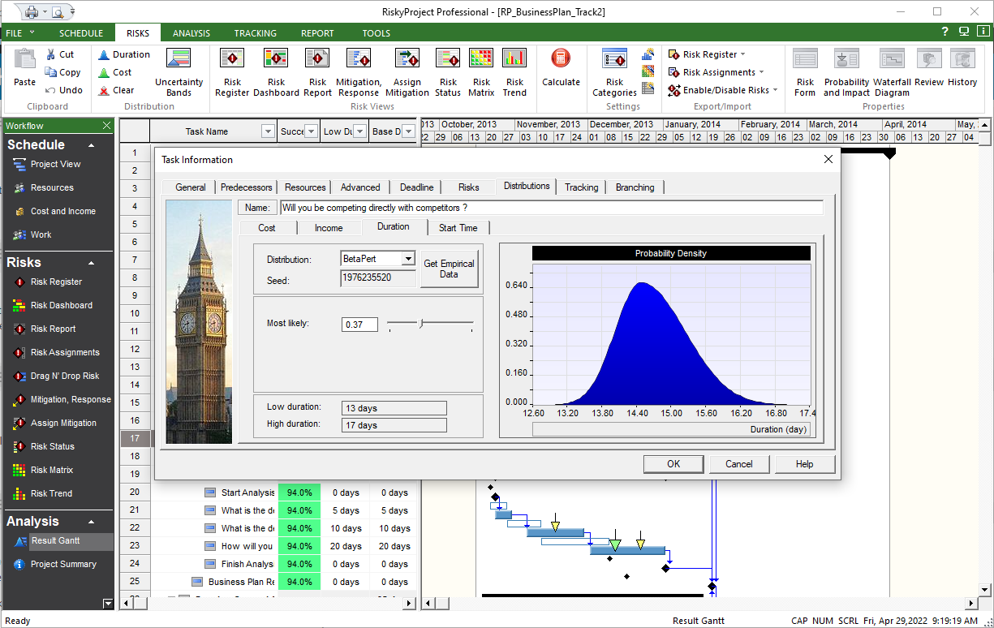
Statistical Distributions
In addition to risk events you may define uncertainties as statistical distributions for:
task cost
task start time
task duration
income associated with task
If you enter only the low, base and high cost, duration, start time and income, RiskyProject will generate statistical distribution based on this data

Slide 20
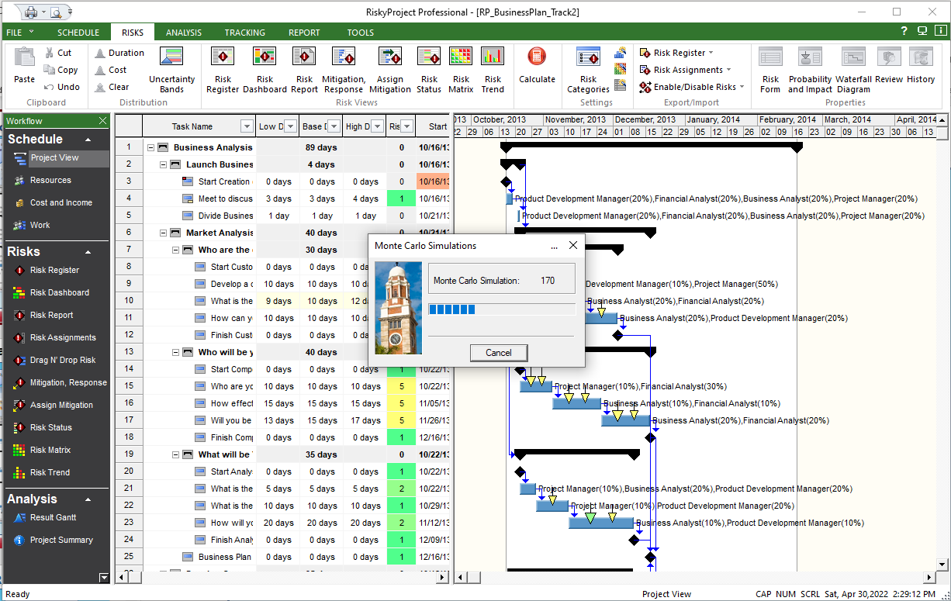
Monte Carlo Simulation
When your project schedule and risk breakdown structure is ready, click here to perform Monte Carlo simulations

Slide 21
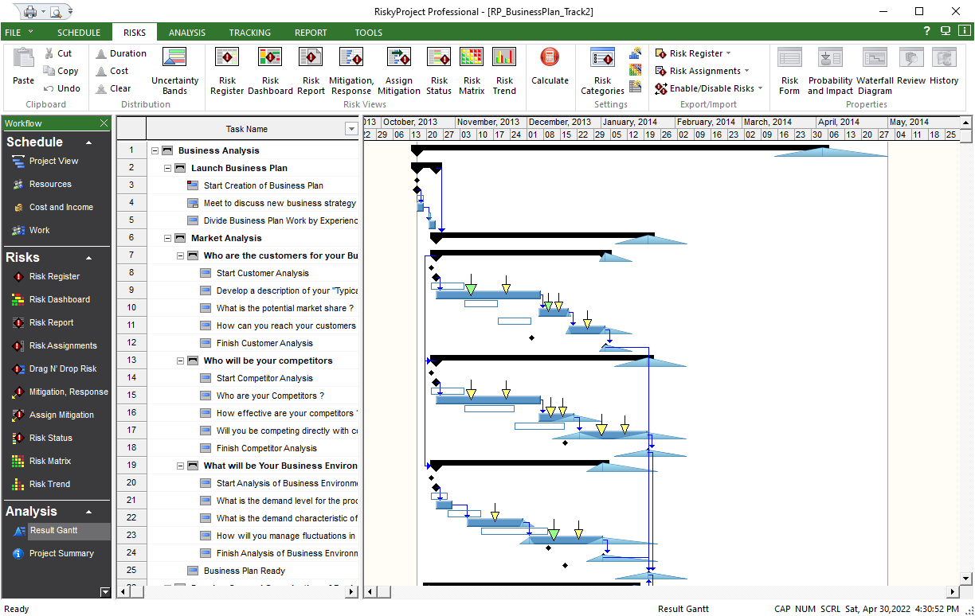
Risk Adjusted Project Schedule
Compare original project schedule and result of analysis
White bars represent original project schedule (no risks)
Blue bars represent risk adjusted project schedule (with risks and uncertainties)

Slide 22
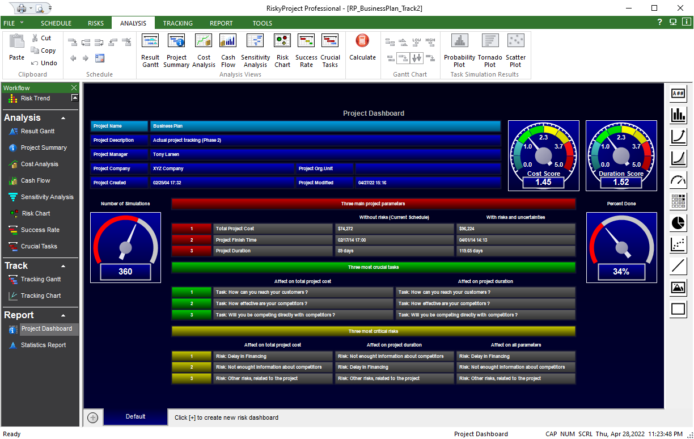
Project Dashboard
Select different charts, graphs and indicators.
Draw and drop then on the dashboard
Create any number of tabs representing different dashboards

Slide 23
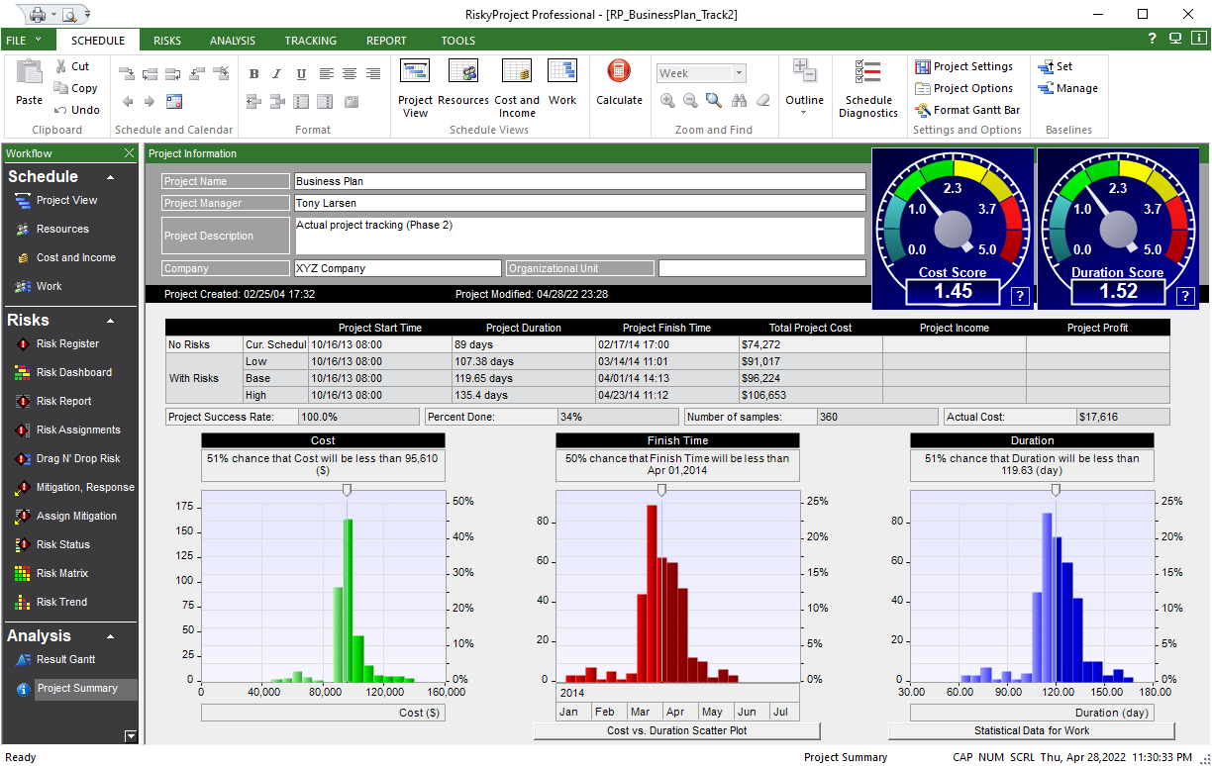
Results of Risk Analysis
Project Summary: project duration, cost, and finish time with and without risks
The meters show project risk score for cost and duration
Results of analysis for project cost, finish time, and duration
Double click on any chart to view detailed information

Slide 24
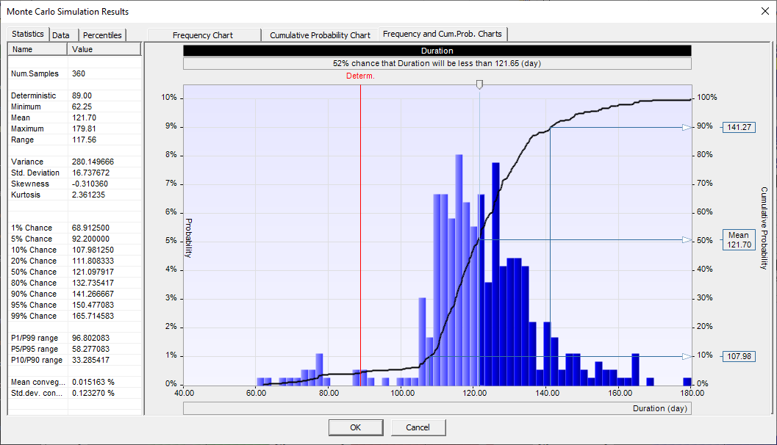
Detailed Results of Analysis
Move the slider to determine the chance that project will be within budget
Detailed results can be shown for each task or project for cost, duration, start time, finish time, and income.
Get detailed statistical data
Data can be exported as an image or text

Slide 25
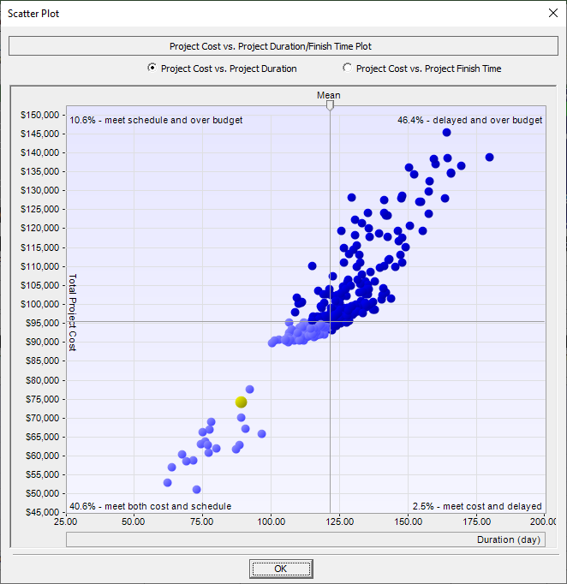
Cost vs. Schedule Scatter Plot
Move the slider to determine the chance of meeting both schedule and budget
This plot is often referred to as the “Bull’s eye” or “Football” chart
Base
Estimate indicated by yellow dot

Slide 26
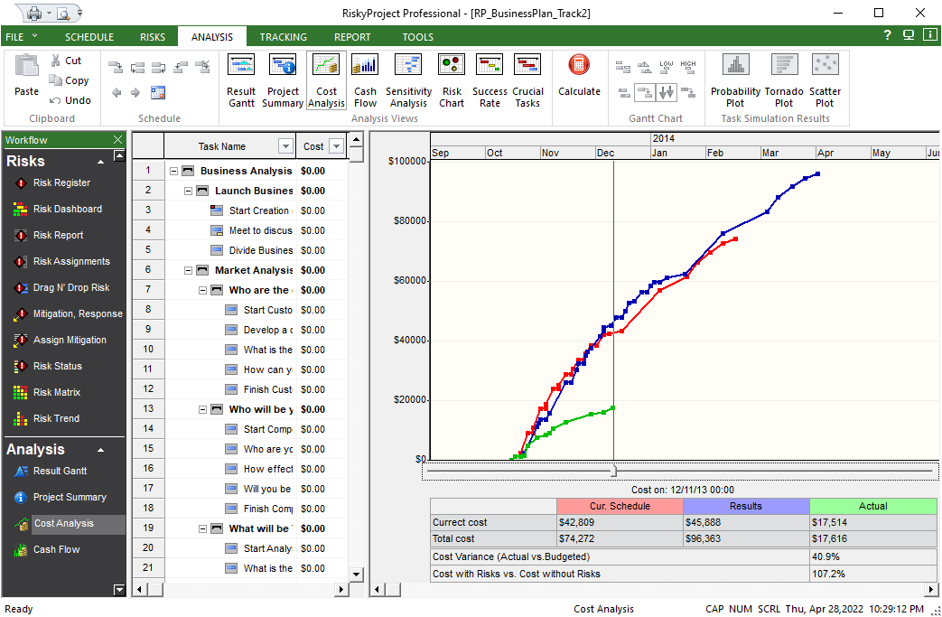
Cost Analysis
Project cost with risks (blue line)
Project cost without risks (red line)
Actual cost (green line)
Cost chart is generated based on fixed and variables cost and income associated with tasks and resources

Slide 27
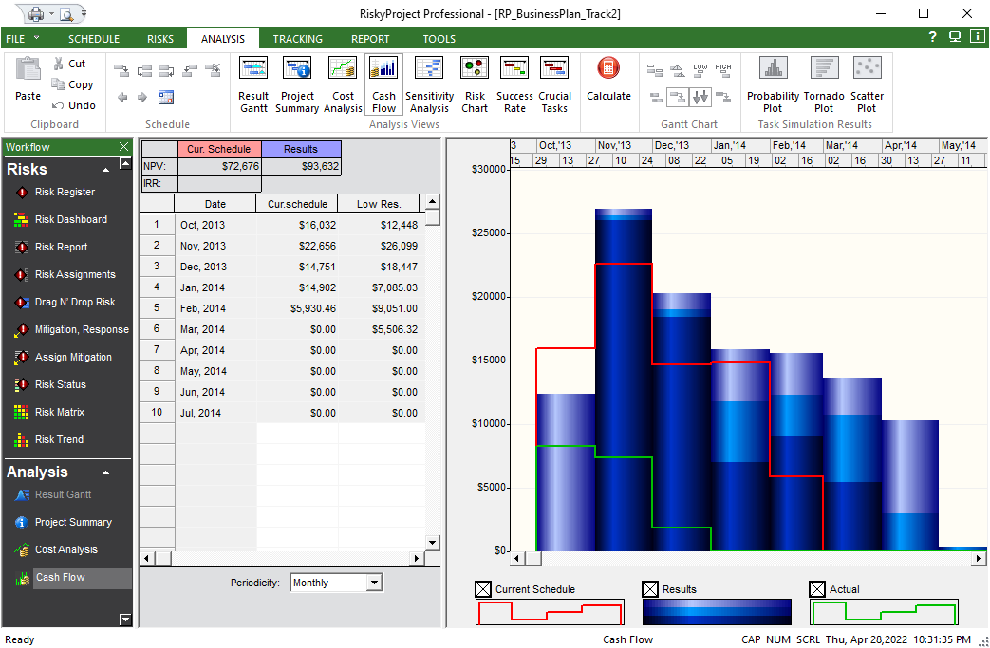
Probabilistic Cash Flow Analysis
Cash flow with risks (blue bars)
Project cost without risks (red line)
Cash flow is generated based on fixed and variables cost and income associated with tasks and resources
Actual cost (green line)

Slide 28
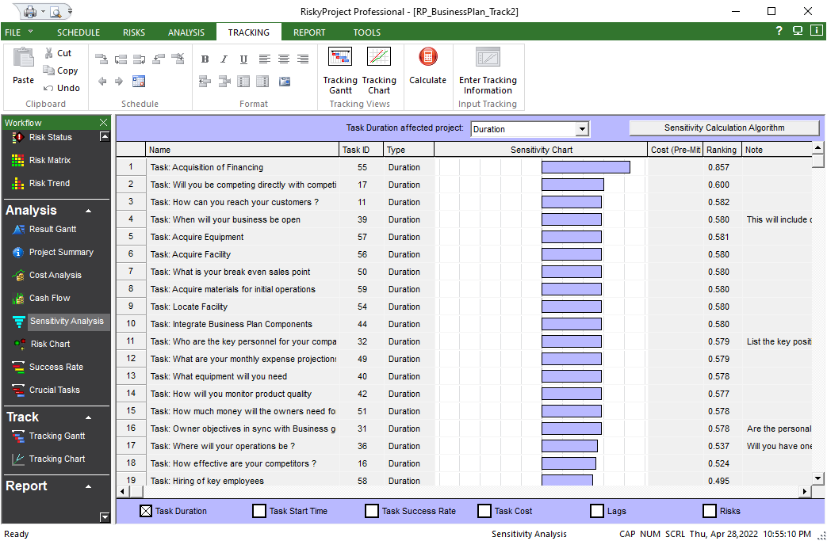
Sensitivity Analysis
Prioritize critical task or risks
Tornado chart shows risks or other parameters that have the most affect on the project schedule

Slide 29
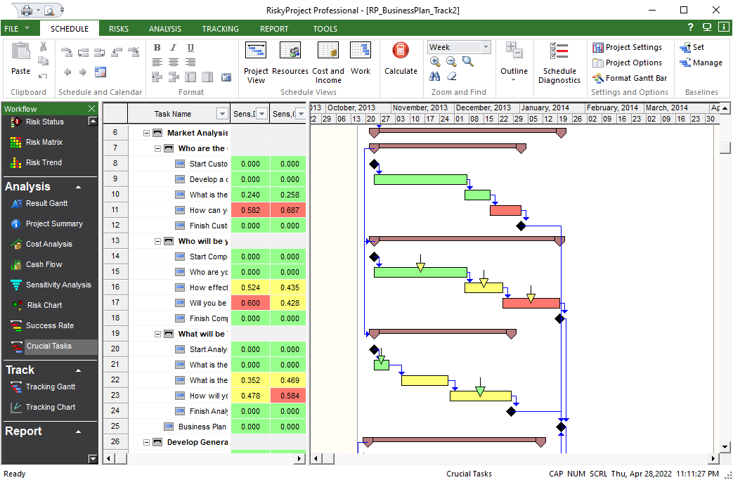
Crucial Tasks
Crucial tasks for project cost and duration can be different
Crucial tasks are red
Crucial tasks have the most effect on the project schedule

Slide 30
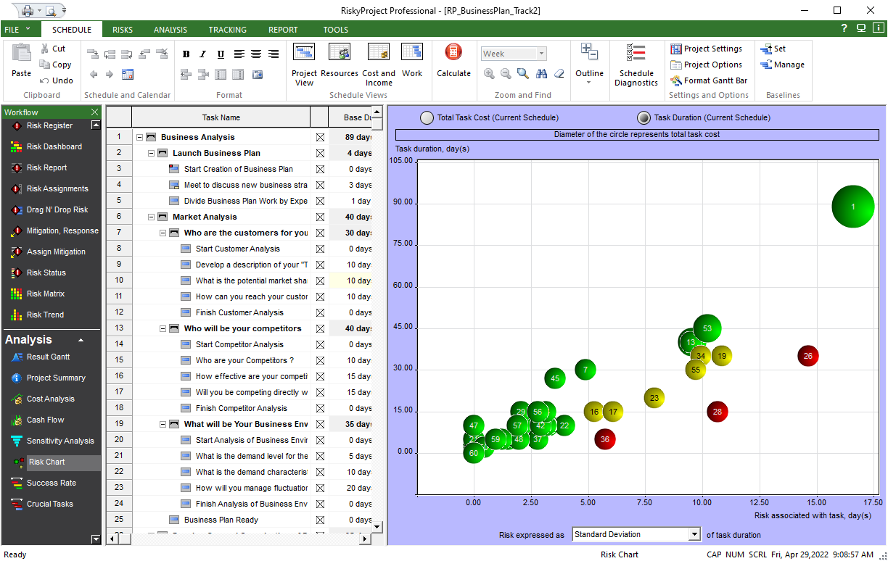
Risk Chart
Risk chart shows task duration and versus risk, associated with task
This task has low duration but high risk
These tasks have balanced risk versus duration ratio.

Slide 31
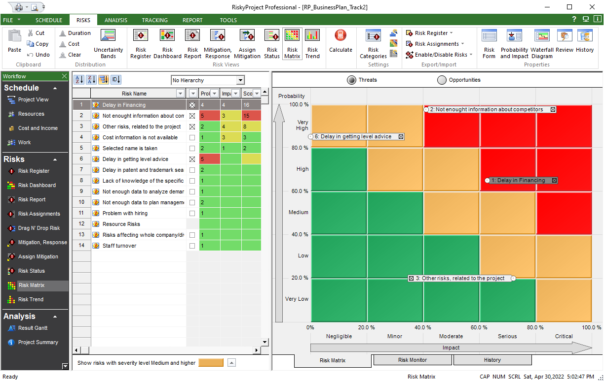
Risk Matrix
Probability vs. Impact Chart
Risk Probability, Impact and Score for the current schedule
Filter Risks based on Severity

Slide 32
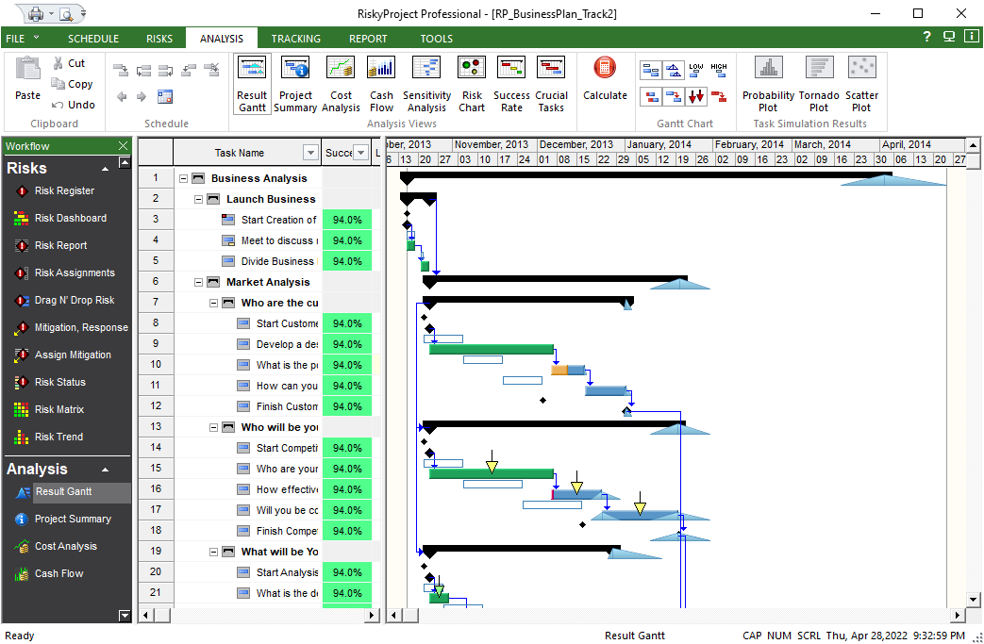
Project Tracking
This task is 100% completed (green bar)
This task is partially completed (yellow bar)
Risky project automatically adjusts the probability of risks for partially completed tasks

Slide 33
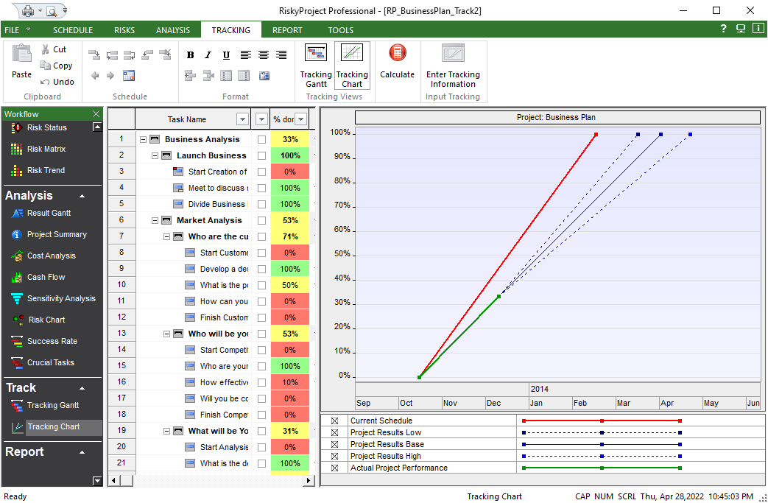
Forecast Project Finish TIME
Low, base, and high forecast
Original (baseline) project duration
Actual project performance

Slide 34
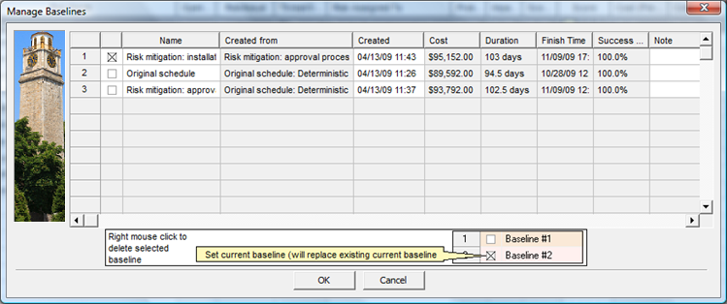
Managing Baselines
Compare different baselines
View results for each baseline
Select the working schedule that you will use to manage the project
Select the current schedule
Compare results for each baseline

Slide 35
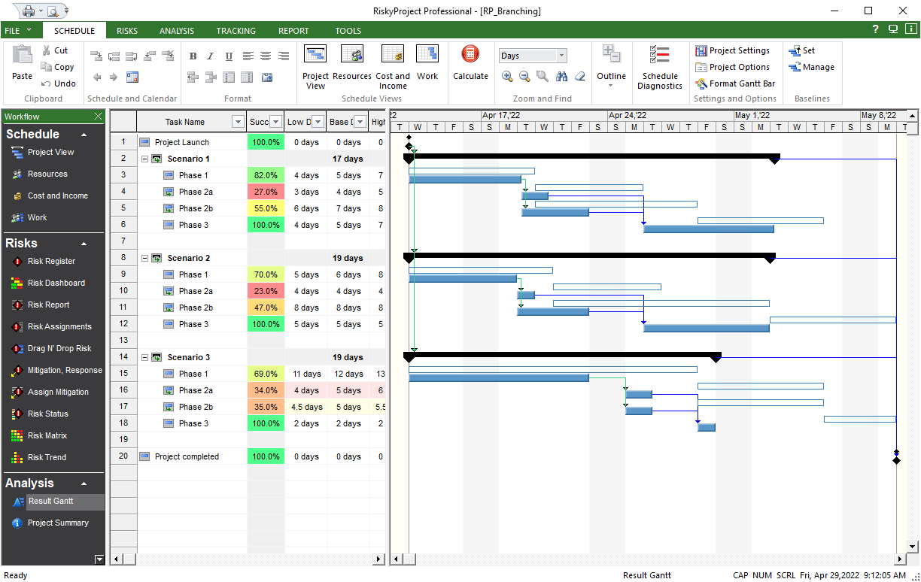
Branching
Conditional and Probabilistic Branching
Model different scenarios when project activities are uncertain
Calculate Expected Value of project given uncertainties in project activities
Run alternative project branches probabilistically

Slide 36
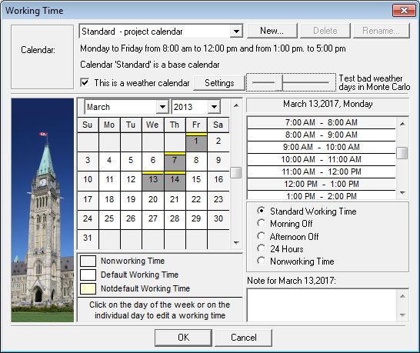
Weather Calendar
Weather Calendar
  Model non working days due to weather
Weather calendar settings: number of non-working days due to weather each month
Non working days due to weather

Slide 37
RiskyProject
Learn more about RiskyProject
www.intaver.com
Intaver Institute Inc.
400, 7015, Macleod Tr. S.
Calgary, AB, Canada
Tel: +1 (403) 692-2252
4280 East Tamiami Trail, 302-M, Naples Florida, 34112, USA
Tel: +1(510) 984 3527

