Slide 1

RiskyProject Project Risk Management and Risk Analysis Software
Risk Management Process of Oil and Gas Companies
Lev Virine, PhD, P.Eng
Intaver Institute Inc.

Slide 2
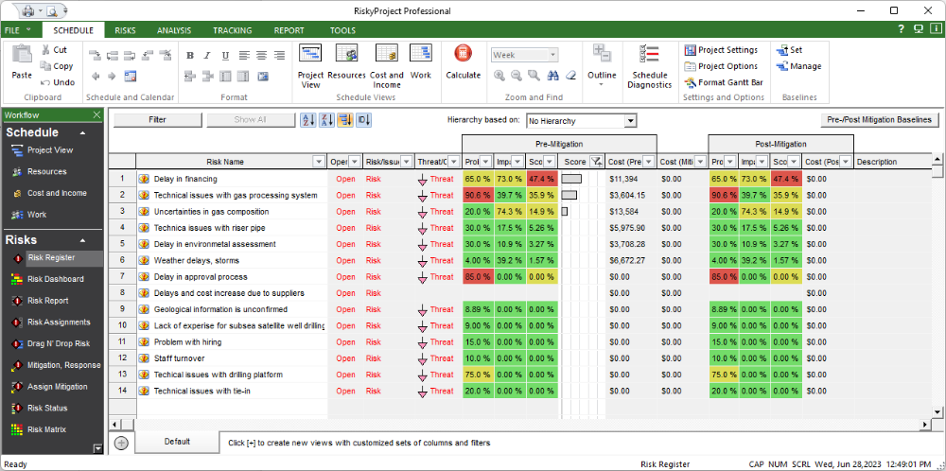
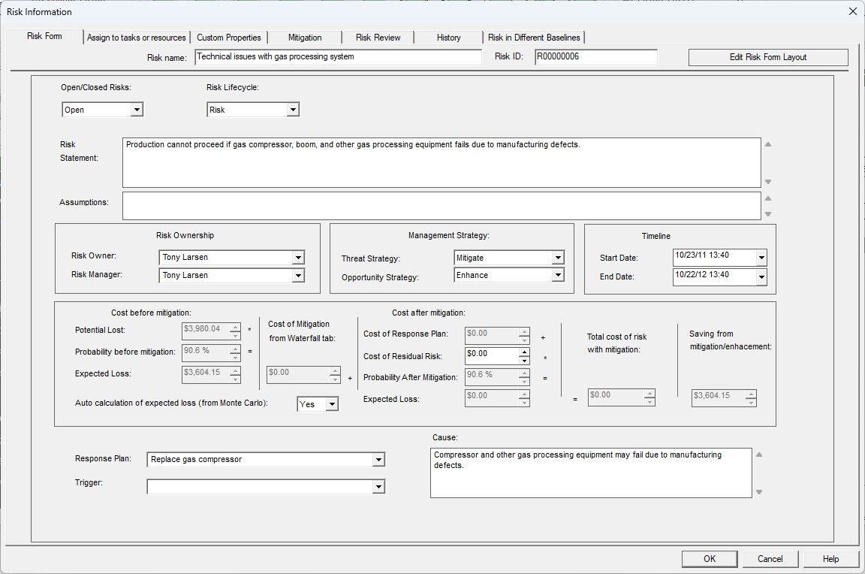
Corporate Risk Register
RiskyProject’s Risk Register include all information about risks: probabilities and impacts, properties, mitigation plans, etc.
Risks from Risk Register can be assigned to different projects, and within a project to different tasks and resources
Risk Properties in RiskyProject
In RiskyProject Corporate Risk Register is shared among all groups and divisions of the company. One risk may affect different divisions.
Exploration
Production
Capital Projects
Public Relations
Finance
Strategic Planning
IT
……

Slide 3
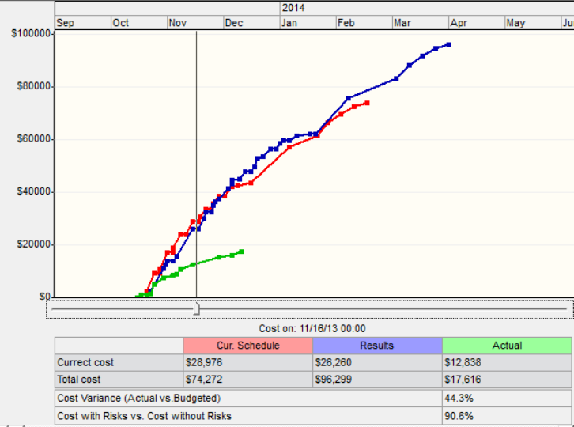
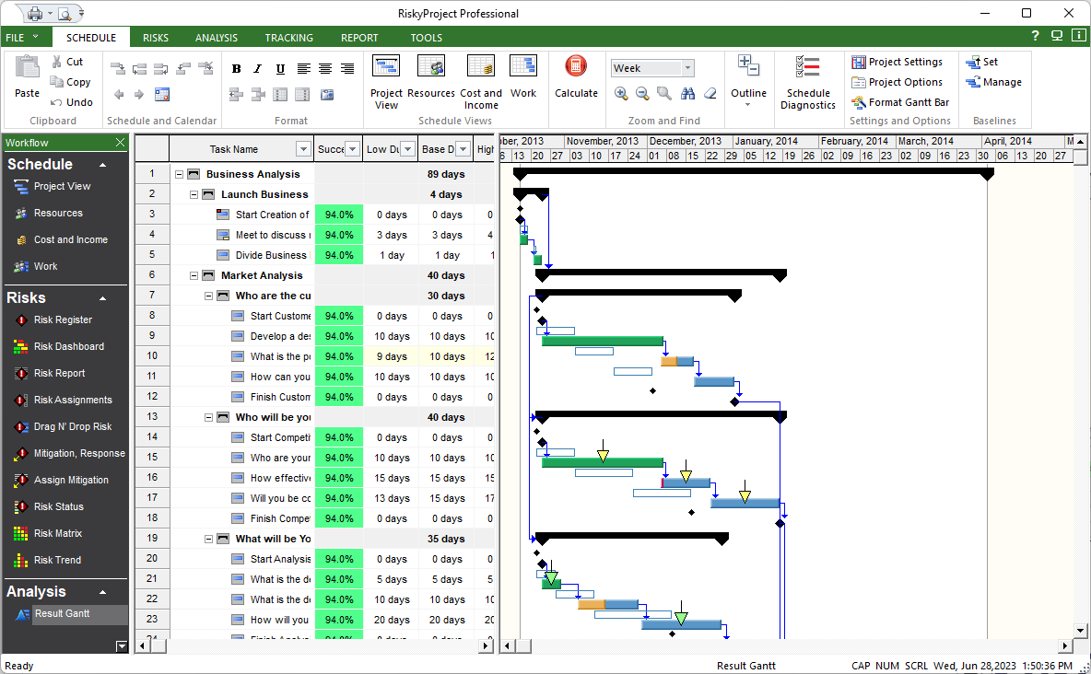
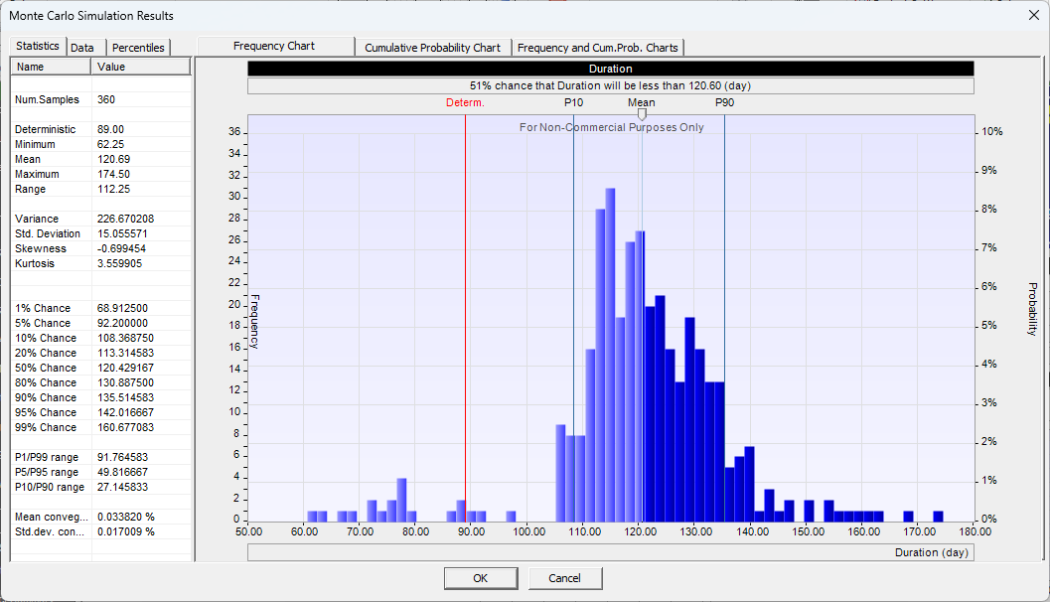
Monte Carlo Schedule and Cost Risk Analysis
Risk adjusted project schedules
Probabilistic Cost Analysis
Uncertainties in project duration, cost, start and finish times, work, etc.
RiskyProject offers a comprehensive schedule and cost risk analysis. Risk Register and uncertainties in task duration/cost serve as an input for risk analysis.

Slide 4
Comprehensive Uncertainty Management in
Oil and Gas Company
Economic Evaluation of Oil and Gas reserves and resources
NPV, ROI, and other economic indicator
Decision to proceed with the project
Information from Corporate risk register is used not only in Monte Carlo schedule and cost risk analysis, but in other areas of oil and gas company’s operation.
Results of cost risk analysis in form of statistical distributions can be used in economic evaluation of oil and gas reserves using software such as Schlumberger Merak Peep and Decision Tool kit, Quorum Software’s Value Navigator, and others.
RiskyProject
Assessment of Company’s resources:
Monte Carlo schedule and cost risk analysis in RiskyProject
Financial
Human
Corporate Risk Register
Material
Project schedule can be imported from Oracle Primavera P6, MS Project, or other software.
ESG, security, PR/Investor’s relations, other company’s activities
Risk Register can be imported from Excel or other software

Slide 5
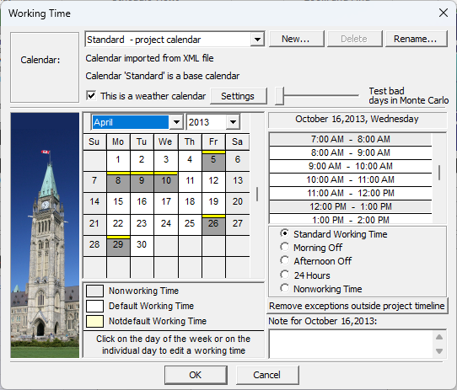
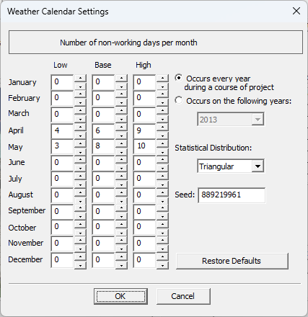
Weather Calendars
Weather calendar is specifically design for oil and gas industry and specifically for off-shore exploration and production
It allows to define non-working days for selected months
Such non-working days can be probabilistic; input information is based on historical information about the weather
Probabilistic not working days
Distribution of non-working days for the month

Slide 6
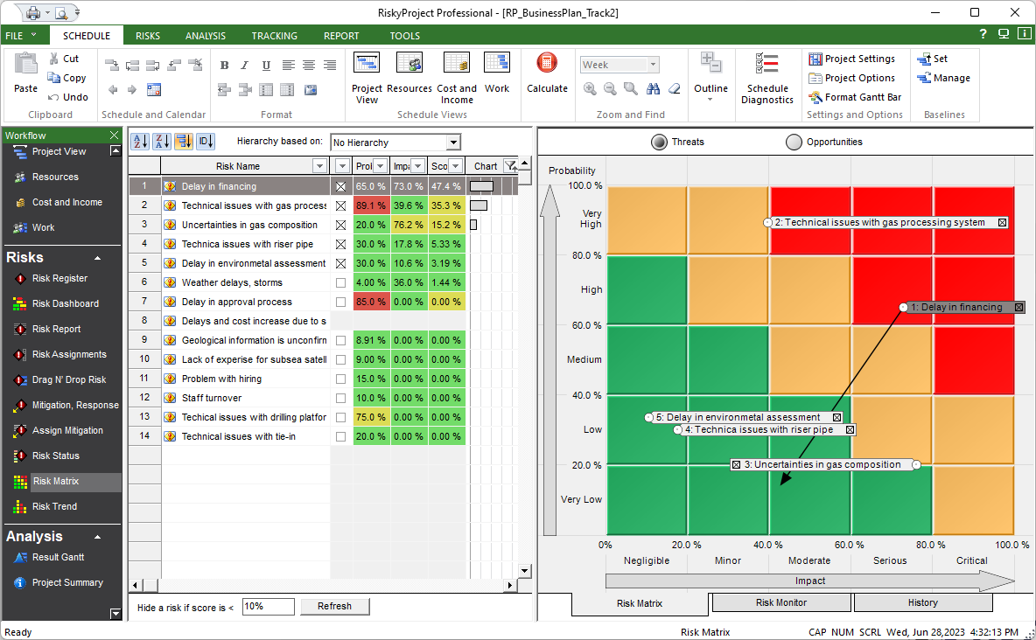
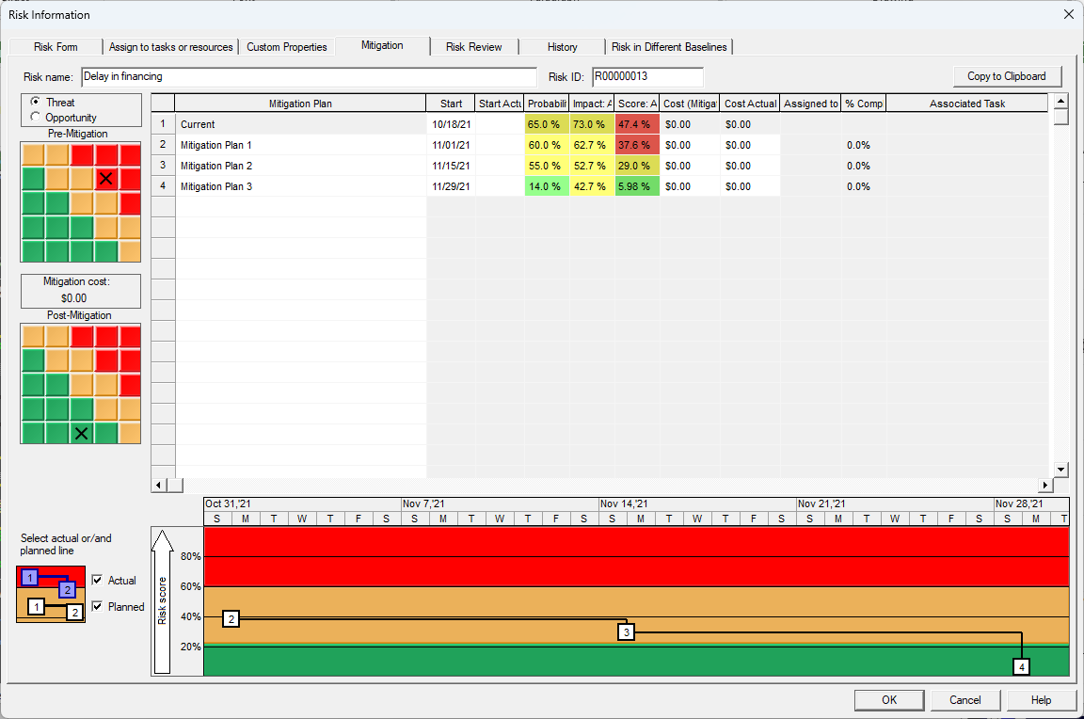
Qualitative Risk Analysis and Risk Mitigation
Risk Matrix and Risk Register
Mitigation Plans assigned to the risk
RiskyProject allows to perform qualitative risk analysis. It allows to manage risk lifecycle during all phases of oil and gas projects: from exploration to development and production
RiskyProject includes extensive risk mitigation functionalities. In RiskyProject oil and gas companies can define risk mitigation sub-projects and assign them to the specific risk.

Slide 7
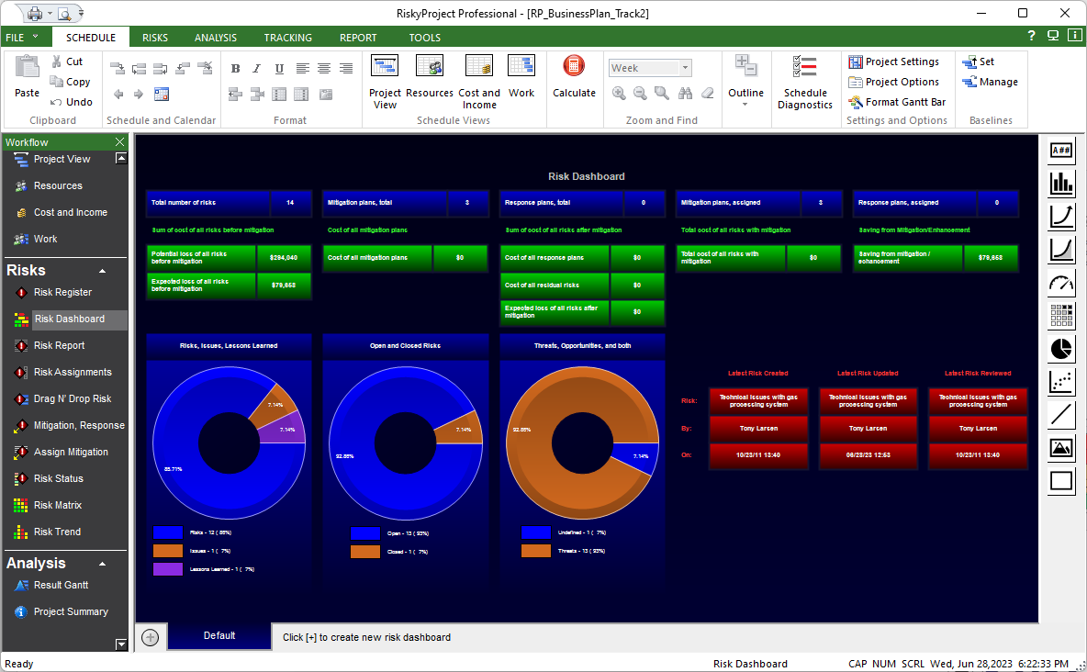
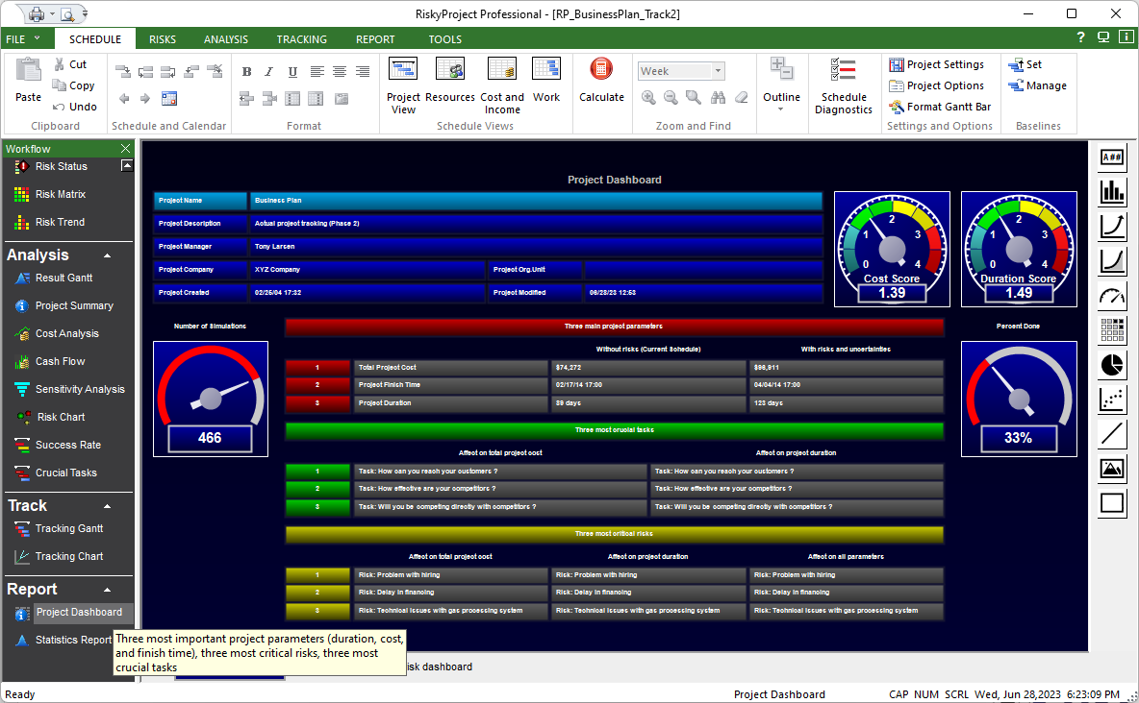
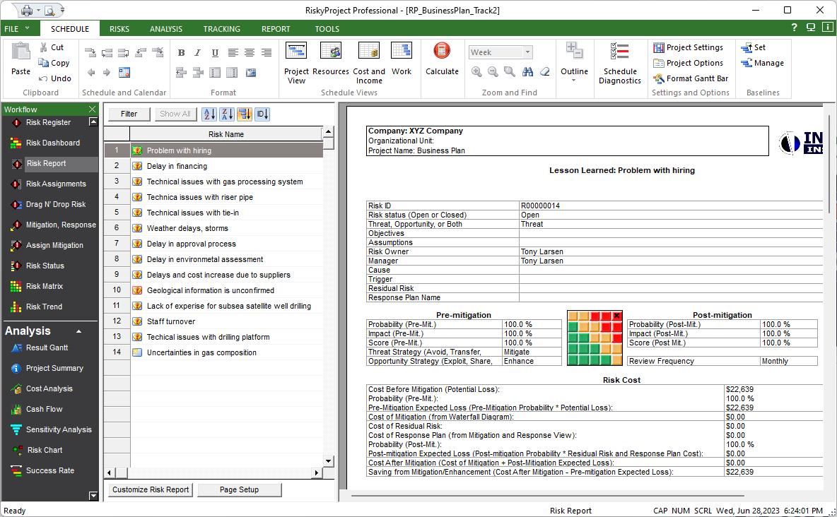
Customizable Reports and Dashboards
Risk Dashboard
Project Dashboard
Risk Reports
RiskyProject comes with extensive set of reports and dashboards. All of them are customizable. Oil and gas company may create a customized dashboard or report to present the selected values or the chart.

