Slide 1
How to Model Cost Risk for Monte Carlo Analysis
Intaver Institute Inc.
400, 7015, Macleod Trail,
Calgary, AB, Canada
Tel: +1 (403.) 692-2252
www.intaver.com
Notes:
Welcome to Intaver Institutes video : How to Model Cost Risk for Monte Carlo Analysis. We are going to be taking a detailed look at how costs are calculated and how to apply risks and uncertainties to your cost model for Monte Carlo risk analysis.

Slide 2
Two Sources of Cost
Fixed Costs
Not time dependent
Can represent any costs
Are not calculated based on Work
Resource Costs
Associated with work, material and cost resources
Can be time dependent and calculated based on Work
Notes:
In RiskyProject, costs can be divided in the two main categories.
Fixed Costs. Fixed costs can be used to represent any costs are not time related due to resource allocation. Typically, they will represent costs that are not related to specific resources.
Resources costs: Resource costs are based on the hourly rates or cost per use of resources assigned to activities. Resource costs can be used to calculate time dependent costs using resource rates.
* Cost Type resources are a special case as they are a way of allocating cost to a specific activity and are a hybrid method that shares characteristics of both fixed costs and resource costs.

Slide 3
Two Sources of Risk
Uncertainty
3 point estimate (low, most likely, high)
Statistical Distribution (triangular, lognormal, BetaPert, etc)
Risk events
Probability
Impact (Fixed or Relative)
Defined in Risk Register
Notes:
When creating a cost risk model, we can apply two types of risk to our costs: Uncertainty and Risk Events
Uncertainty is characterized by 3 point estimates (low, most likely, and high) combined with a statistical distribution. Uncertainty can be applied to both duration and costs for the purpose of cost analysis.
Risk events are also sometime referred to as “risk drivers” and are characterized by a probability of occurrence and impacts. For cost risk analysis, both fixed cost and schedule impacts can be used.

Slide 4
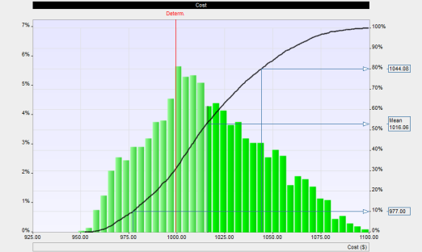
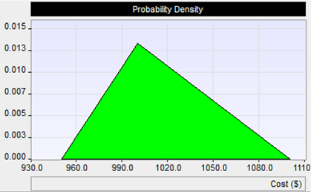
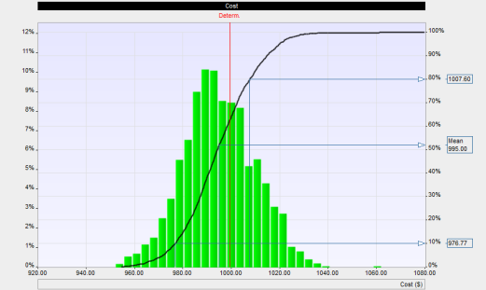
Uncertainties in Fixed Costs
Inputs
Results
Low:$950
Most Likely:$1000
High:$1110
Triangular
Lognormal
Add cost uncertainty by adding Low, Most Likely, and High estimates with a statistical distribution
The result on a single cost item with different distributions
Notes:
Here we show how we can apply uncertainty to a fixed cost.
The Base or Most Likely cost is $1000.
The low or optimistic is $950 and the High or pessimistic is $1100.
A visual representation of the these estimates with a triangular statistical distribution is shown on the left.
On the right, we can see can see the results of an analysis using two different types of statistical distributions. Different distributions can affect statistical measures like standard deviation. On the top example, we can see that the triangular distribution has “fatter” tails or results have a higher probability of landing farther from the Most Likely value than in the Lognormal distribution.

Slide 5
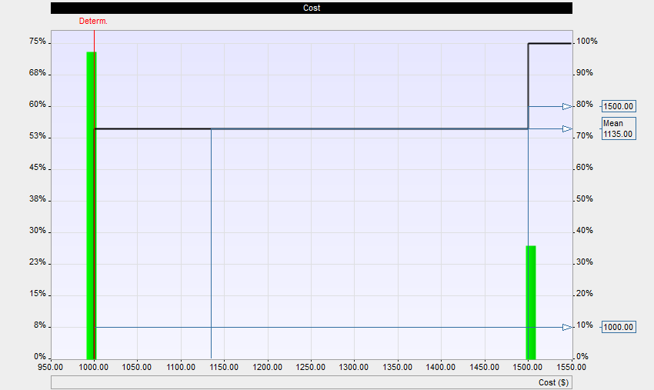
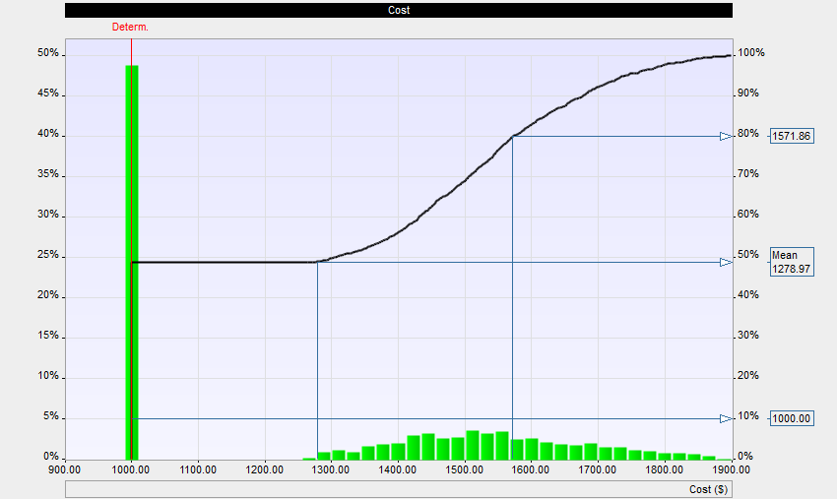
Risk Events and Fixed Costs
Inputs
Results
Single Impact
Fixed cost increase of $1,500
Chance 35%
Ranged Impact
Fixed cost increase
between $1,200 and $1,900
Chance 35%
Add risk events with Probability, Impact Type (fixed or relative), and Statistical Distribution (if required)
Notes:
Risk events are risks that are found in the risk register. The have a probability of occurring and an impact.
Probabilities are between 0 and 100%.
Impacts can be fixed or relative (a % of the base cost)
Impacts can be a discrete value or can be modeled as an uncertainty with a range of values defined by a statistical distribution.
In the first example with a discrete impact, the risk appears as a single bar in the histogram.
In the second example, with a ranged impact, the risk appears as a small distribution to the right of the base estimate.
As we can see, the way we choose to model the risks can have a significant impact on the results.

Slide 6



Work Cost Calculation
This resource has a rate of $100/hr
The resource has been assigned to a 5 day task
The resource allocation of 100% generates 40 hrs of work
The cost of the resource = (Hours Work x Rate)
40 hours x $100/hr = $4000
Work rate based resources are time dependent!
Notes:
Work is the fundamental unit of the time dependent cost calculation.
Work is a function of the resource allocation. Resource units indicates the level of allocation or % of the activity duration that the resource will be working on an activity.
For the purposes of this discussion, we are using the commonly used “fixed unit” task type, which keeps resource allocations (units) fixed and recalculates work if duration is modified. We will discuss the appropriate use of other task types in a future video.
In this example we can see how the base costs for a resource assigned to a task is calculated.
If we lowered the Max units to 50%, the Work performed by the resource over the same period would be reduced to 20 hours at a cost of $2000.
The other thing to take note is that if the duration changes, work and therefore resource costs are adjusted accordingly. In this way resources can be used to model time dependent costs.

Slide 7
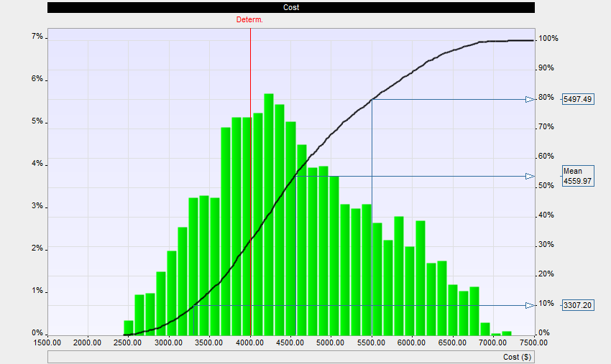

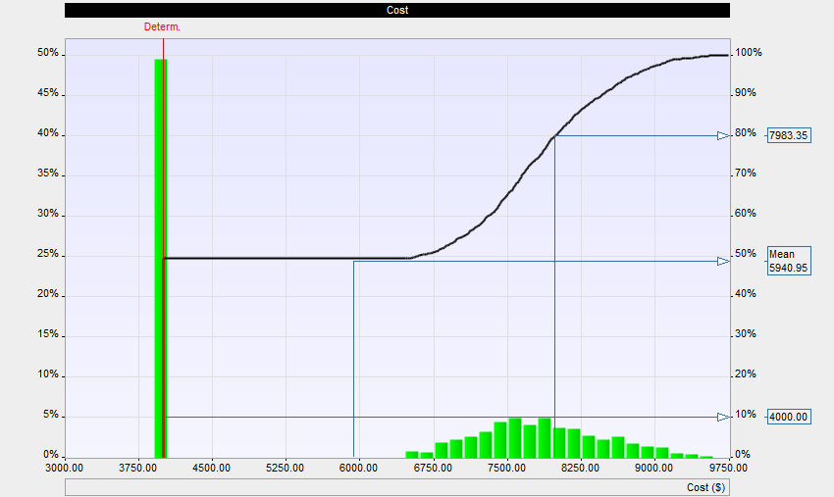
Time Dependent Resource Costs
Inputs
Results
Schedule Uncertainty
Schedule Risk Event
Notes:
Work based resource costs can be risked as part of integrated approach of cost and schedule risk analysis.
Both schedule uncertainty and risk events impact work based resource costs.
In these examples we show how schedule uncertainty and riska are presented on a combined histogram and cumulative probability chart.

Slide 8
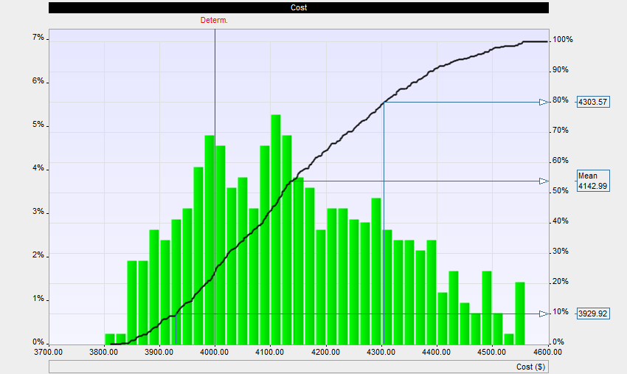
Rate Risks
Input
Results
Rate increase risk (work type resource only)
Notes:
Work based risks can also be affected by non schedule risks. These are called rate increase risks where we can apply either a relative or fixed impacts to the resource rate.
In this way, you can account for uncertainty in labour rate.
As with the previous examples, we can see the results of the rate uncertainty on the probable cost of the activity.
Rate risks are assigned in the Resource Information dialog box > Risks tab.
Once the risk has been assigned to the resource, the risk is applied or “broadcasted” to all of the activities to which the resource is assigned.

Slide 9




Material Costs Calculation
This material resource has a rate of $750
The material resource does not generate Work hrs
Materials costs are calculated using Units, e.g. 1.5 tons
The cost of the resource =
Units allocated x Rate1.5 tons x $750 = $1,125
Material resource costs are not time dependent
Notes:
Another type of resource are material costs.
Material costs are not based on work, and therefore, not time dependent.
Material resource costs are calculated on a rate/unit. For example in a particular activity, you could have a materials costs of $X/ton.
The material resource is assigned to an activity with a Unit value.
The cost is then allocated to the activity based on the rate and units.

Slide 10

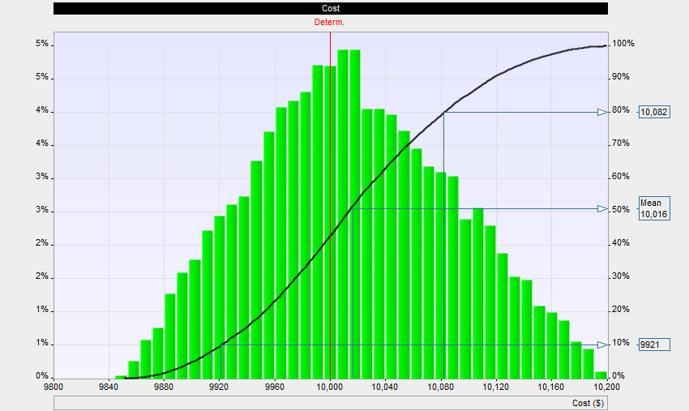
Material Risks
Input
Results
Notes:
Material costs are treated similarly as a fixed costs when it comes to risk events.
Material cost can be risked using the Outcome type “Fixed Cost Increase” Relative cost increase outcome type does not work in this case.
In this example, we can see how we can apply a range of possible rates for the material and its presentation on the chart.
In addition, if you are using Cost Type resources, which are similar to Material costs, cost type resources can be risked for each specific activity using the same method.

Slide 11
Additional Resources
White Papers and Articles: http://intaver.com/technology/articles-and-white-papers/
Online Tutorials: http://intaver.com/RiskyProjectTutorial
Risk and Decision Analysis Books: http://www.projectdecisions.org
Contact Details
Michael Trumper
Intaver Institute Inc.
mtrumper@intaver.com
403.692.2252
Notes:
Thank you for watching our video on Cost Modeling for Monte Carlo Risk Analysis. Please visit our site at intaver.com to learn more about risk analysis and our upcoming videos and webinars.

Slide 12



Additional Resources
Project Think:
Why Good Managers Make Poor Project Choices
Project Decisions: The Art and Science
Introduction to Project Risk Management and Decision Analysis
Project Risk Analysis Made Ridiculously Simple
Notes:
If you are interested in finding out more about Decision Analysis and Risk Management a list of our publications and a variety of resources can be found at our website Project Decisions.org

