Slide 1

RiskyProject Project Risk Management and Risk Analysis Software
Foundation of Project Risk Management and Risk Analysis
www.intaver.com

Slide 2
What is Risk?
Risk is something which may happen and somehow affect the activity, operation or projects.
Threats
Opportunities
Negative effect
Positive effect
Very often threats and opportunity occur together: the same risk may have negative and positive effect. For example, delay in project may lead to reach of new technology application
It is important to identify opportunity together with treats.

Slide 3
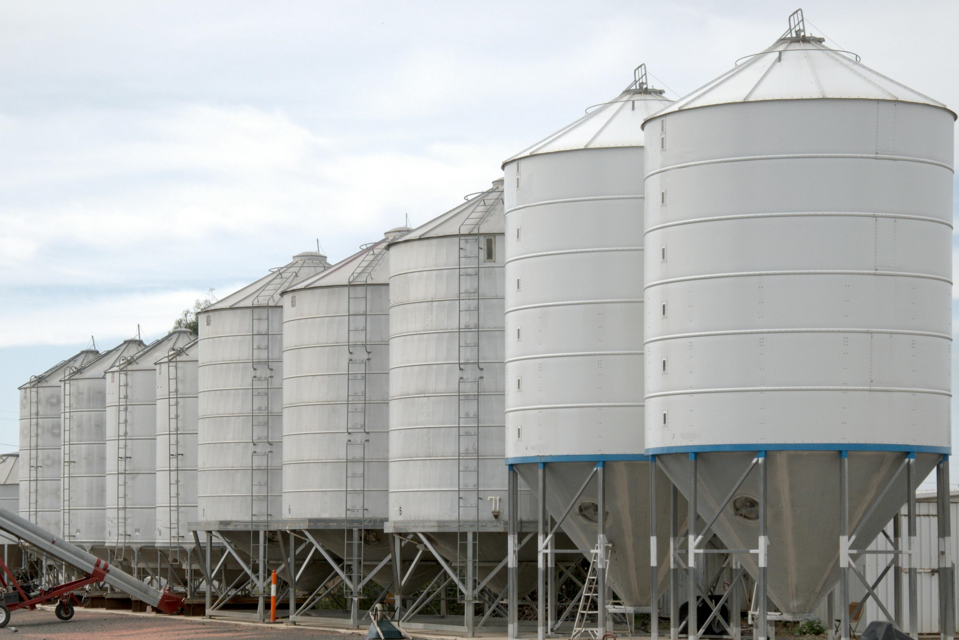
Risks in Different Industries
Risk analysis and management in different industries share similar theoretical approaches and mathematical algorithms
However, industries still exist in different “silos” and experts from different industries often don’t communicate with each other.
Project Risks – risks affecting projects. It is project cost and duration, as wells as safety, security, litigation, PR, environment, technology, etc.
Project is a group of activities which have common goal, start and finish time.
Financial
Risks
Insurance Risks
Political Risks
Physical Risks
Environmental Risks
Security Risks
….

Slide 4
Project Risk Management
The process of identification, analysis, and control risks over time
Three main questions about risks:
1
What could happen?
Risk Identification
2
How will it affect what you are doing?
Risk Analysis
3
What are you going to do about it?
Risk Control, Mitigation and Response
Mitigation: Before risk occurred
Response: After risk occurred
Repeat the process over time

Slide 5
Risks Lifecycle
Risk did not
occur
Issue resolved
Risk
Issue
Lesson Learned
Risk Identified
Risk occurred
Probability = 100%

Slide 6
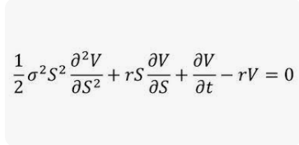
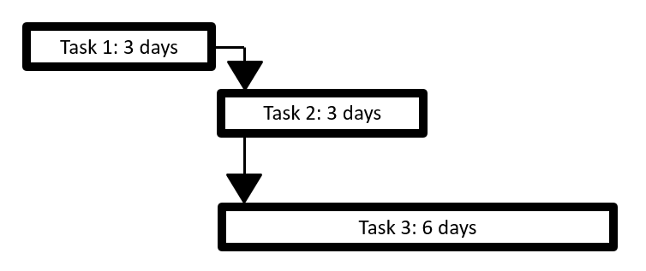
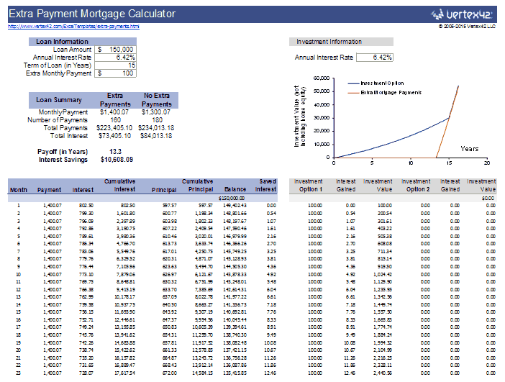
Analytical Models
Mathematical model of the process, which have risks.
Example of the models:
Simple Calculation:
Revenue = Production * Price - Cost
Model in Spreadsheet:
Complex Calculation:
Project Schedules:
Back and Scholes Formula
Mortgage Calculation

Slide 7
Analytical Methods
Quantitative:
Include mathematical analysis of the models
Qualitative:
Analysis of model using user-defined data
Monte Carlo Simulations (include JCL)
Regression Analysis
Correlation Analysis
Different Methods of Decision Analysis (includes AHP)
Bayesian Analysis
…..

Slide 8
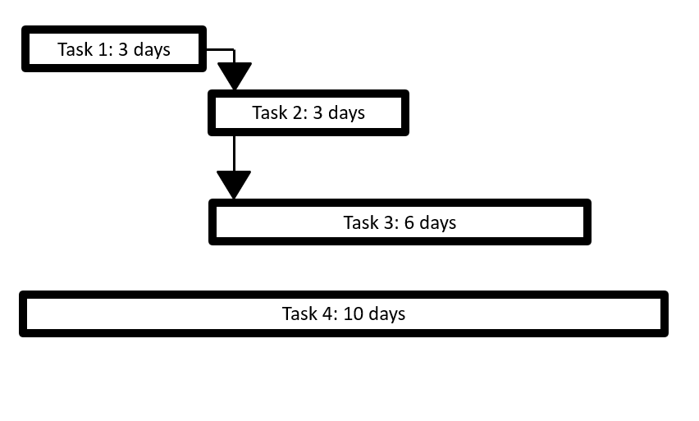
Project Schedule as Mathematical Model
Goal:
Calculation of Duration, Start and Finish Times and other parameters of the Project based on task parameters
Project Duration =
Task 1 + Task 2 or
Task 1 + Task 3 or
Task 4
Result = Task 4 duration
Project schedule is presented on the Gantt chart

Slide 9
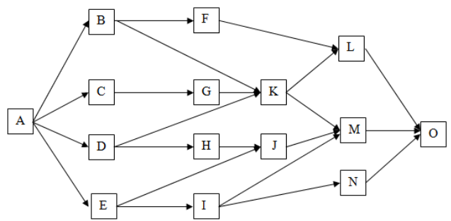
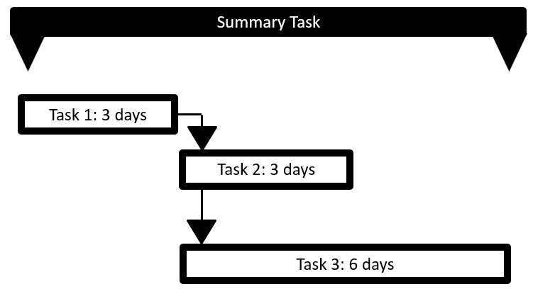
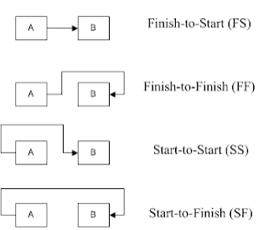
More Complex Project Schedules
Project Schedule Network Diagram
Summary tasks and subtasks
Relationship Between Activities
Project may have:
Resources
Costs
Milestones
Some tasks are completed some don’t
…

Slide 10

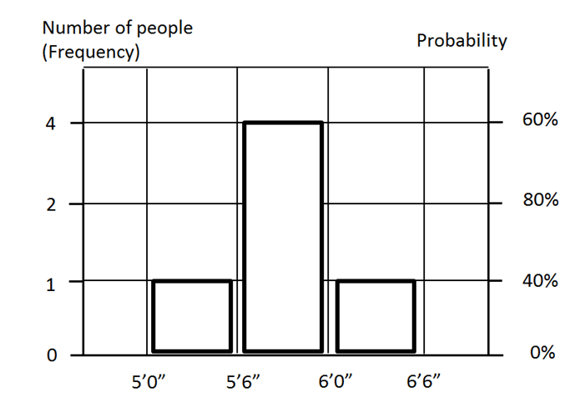
Statistical Distributions
All these people have different heights:
1. 5’10”
2. 6’3”
3. 5’7”
4. 5’11”
5. 5’5”
Group 1: From 5’0 to 5’6” – 1 person
Group 2: From 5’6” to 6’0” – 3 people
Group 3: From 6” to 6’6” – 1 person
Frequency Histogram
Statistical or probability distribution is a relationship between data samples or outcome of a statistical experiment and its probability of occurrence.

Slide 11
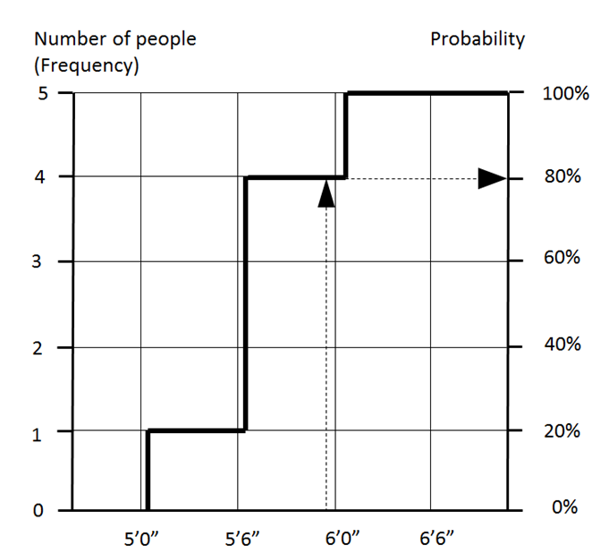
Cumulative Probability

Slide 12
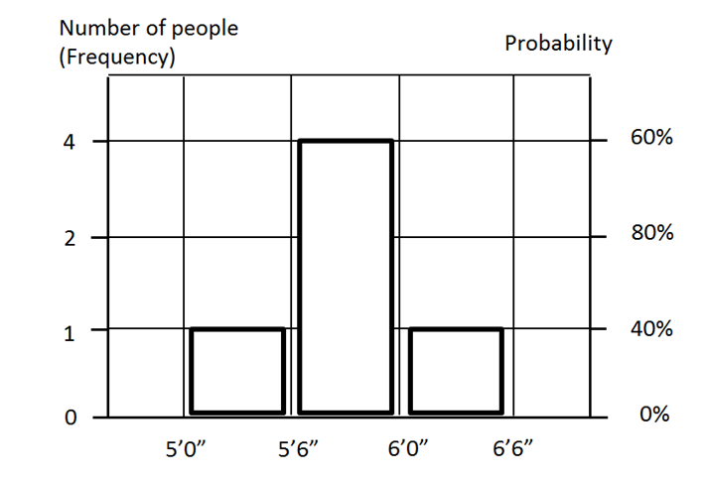
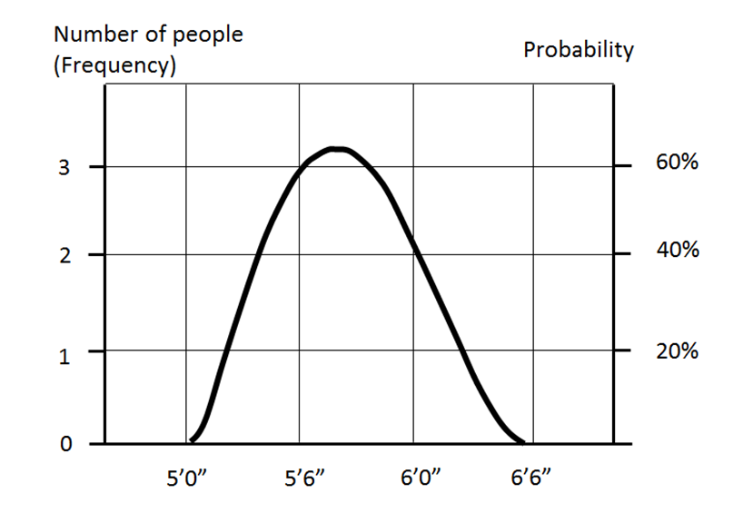
Discrete Distribution vs. Continuous Distribution
Discrete Distribution
Continuous Distribution

Slide 13
Statistical Parameters
Mean: Average Number of all values
Standard Deviation: How wide is distribution.
The tallest man in medical history was Robert Wadlow from Alton, Illinois. He was 8’11.1” (2.72 m). Chandra Bahadur Dangi from Nepal was shortest adult person. He was 21.5” (54.6 cm). The difference in height between tallest and shortest people is 217.4 cm or just over 7’.
Percentile: It is a value on a scale of zero to 100 that indicates the percentage of a distribution that is equal to or below this value.
You have the following 10 values:
20, 22, 10, 5, 34, 40, 48, 7, 32, 49
To calculate percentiles all samples need to be sorted:
5, 7, 10, 20, 22, 32, 34, 40, 48, 49
Number 22 is P50 because there are 5 values below or equal or below 22. Interestingly, P50 is not necessarily the mean, which in this case is 26.7.
Other Parameters: Semi standard deviation, kurtosis, range, maximum and minimum, ….

Slide 14
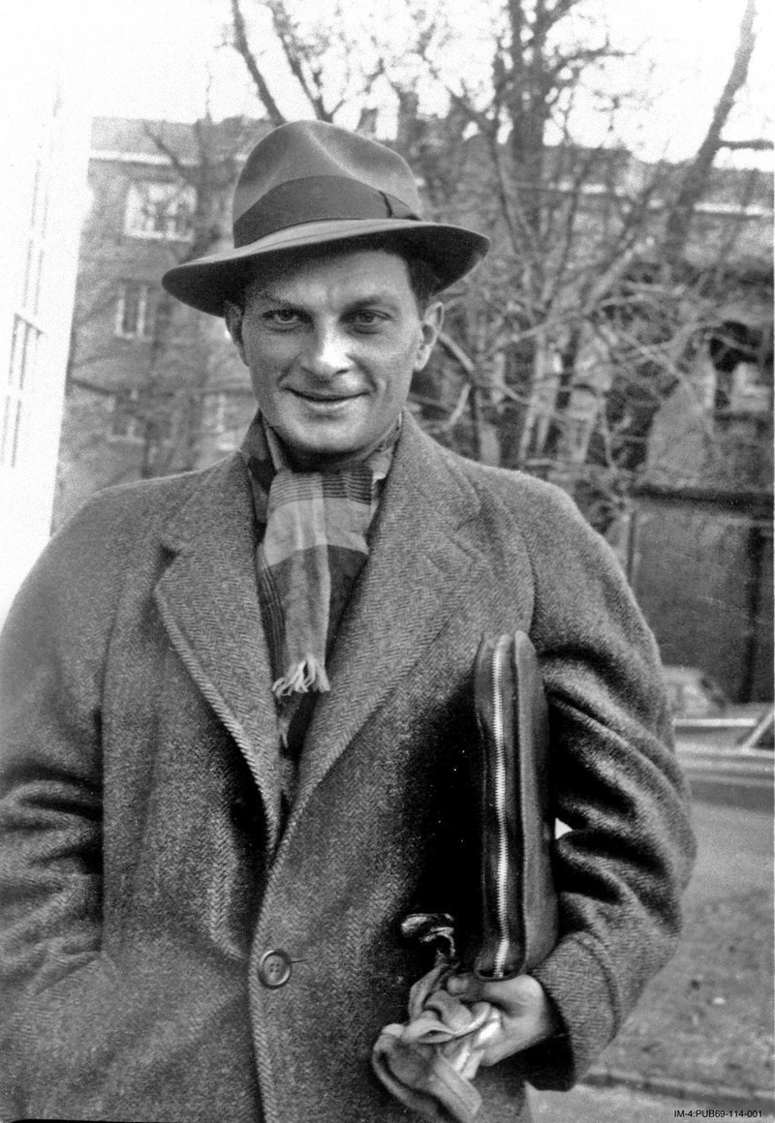

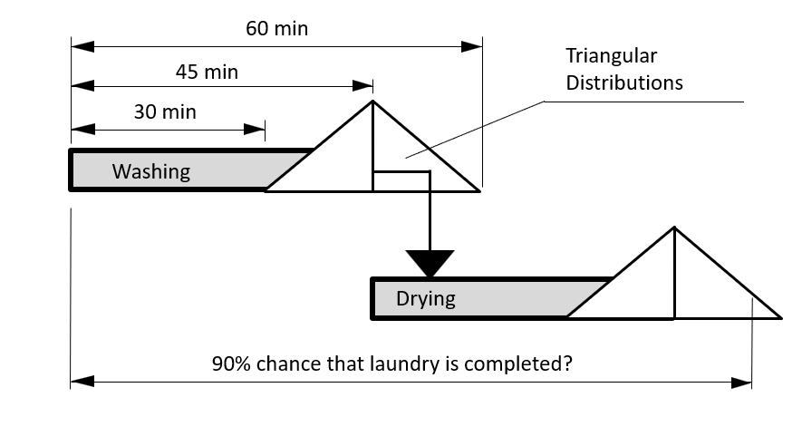
Monte Carlo Simulations
What is the average time in which the laundry will be completed?
What is the chance that you will complete the laundry within 1h and 40 minutes?
How long should you account for to ensure that laundry is 90% complete?
Stanislaw Ulam – one of inventors of
Monte Carlo methodology

Slide 15
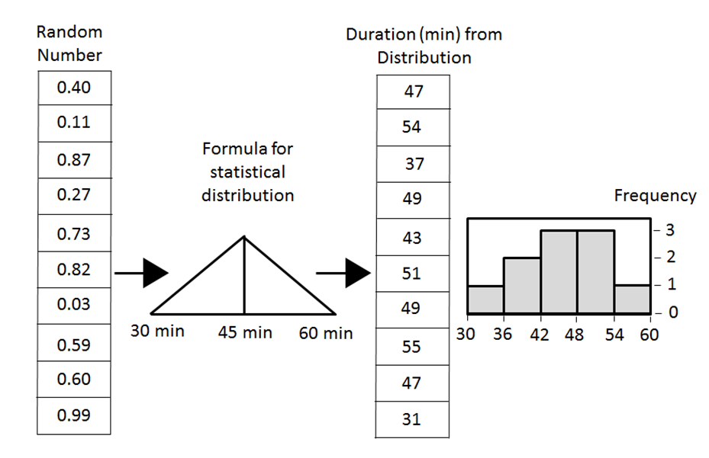
Monte Carlo Simulation Process
For each task generate a random number.
Based on each task’s random number, get a value from the statistical distribution: duration of washing or drying in minutes from a triangular statistical distribution.
Repeat this process for all tasks: washing and drying
Repeat steps 1 to 4 again many times, each time getting a new value for the project duration.
Generate distribution of project duration
Sampling:

Slide 16

“Magic of Sampling”
Seed: Starting random number for sampling
How to get value from distribution using random number:
1. “Drop a ball”
Frequency
Triangular Distributions
2. Get value from random number
3. Save results to array
Value
Number of iterations can be thousands

Slide 17
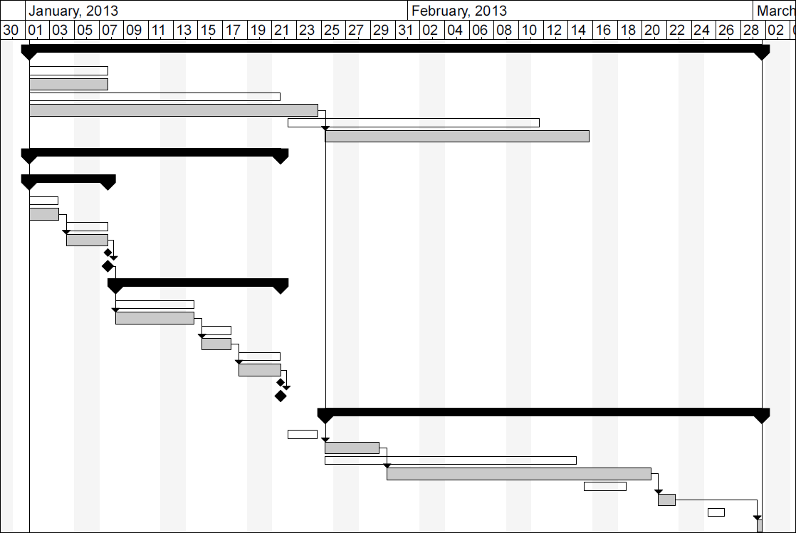
Risk Adjusted Project Schedule
Schedule became longer due to risks
Original Project Schedule
Risk Adjusted Project Schedule

Slide 18
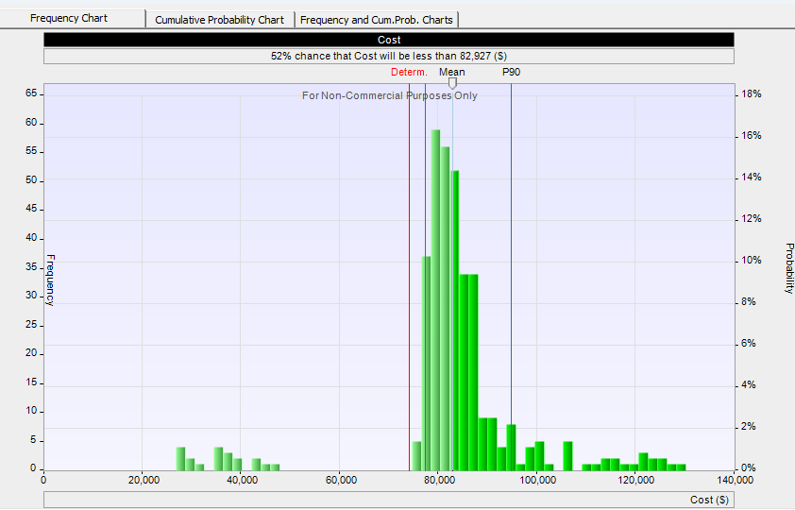
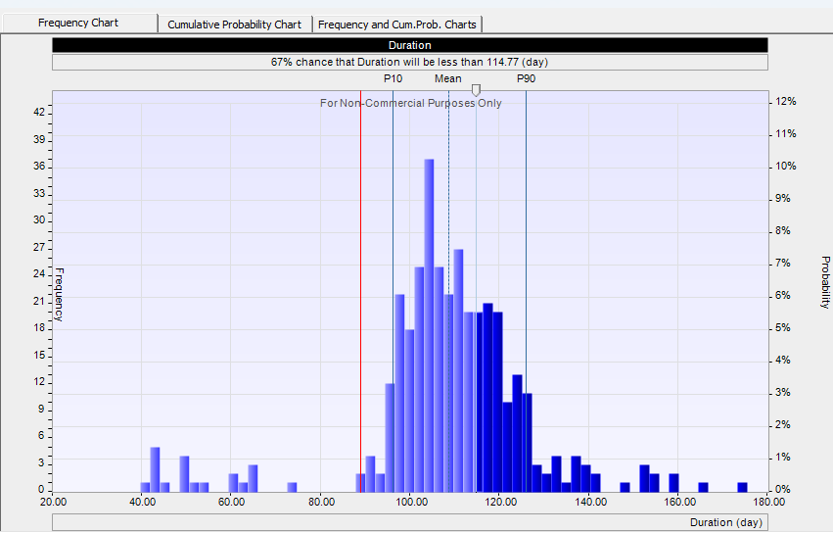
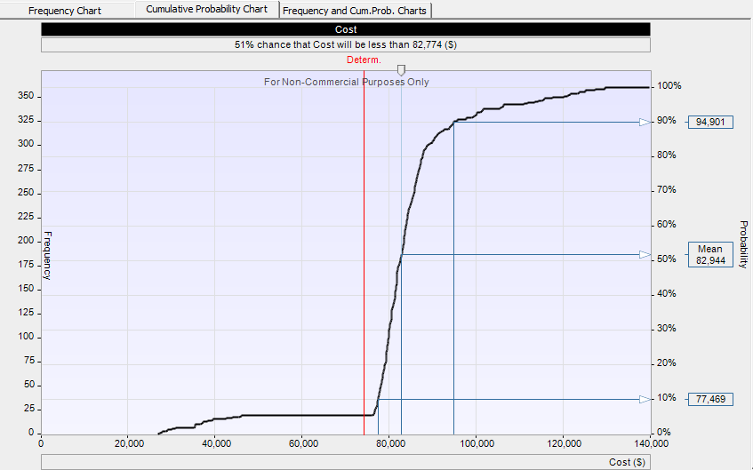
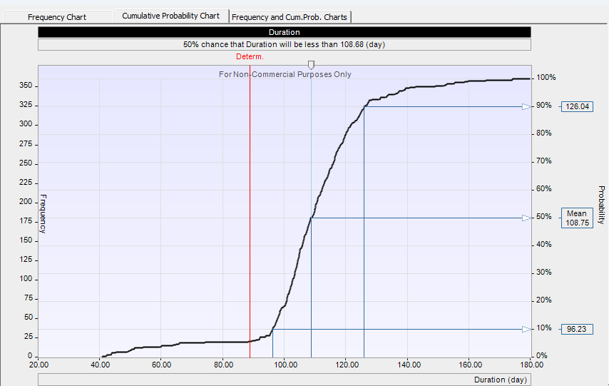
Results of Monte Carlo Analysis
Frequency Chart: Cost
Frequency Chart: Duration
Slider shows chance that project duration will be less than certain number.
Cumulative Probability: Cost
Cumulative Probability: Duration

Slide 19
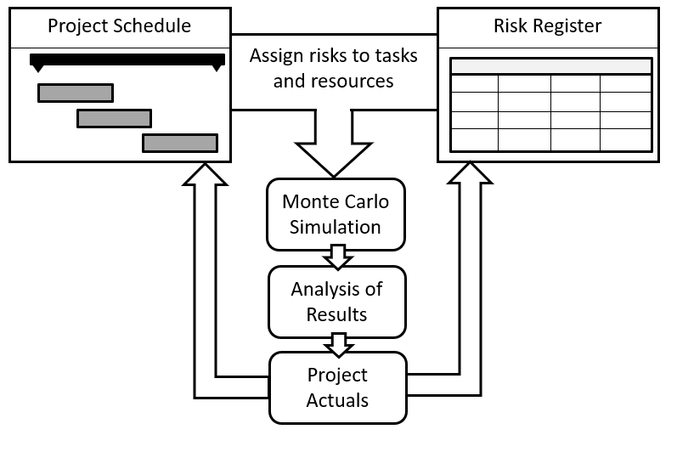
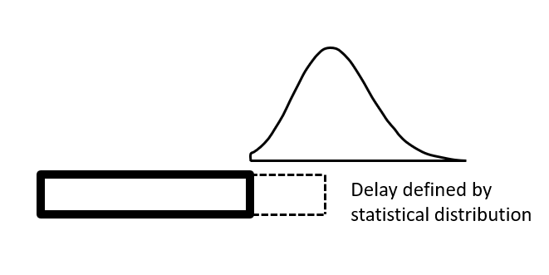
Risk Events vs. Uncertainties
Analysis with uncertainties in task duration and cost:
Analysis with risk events:
Example:
Three points estimate: Task Duration is between 2 and 4 days
Example:
Task detailed on 3 days due to risks “Supplier did not deliver a components”

Slide 20
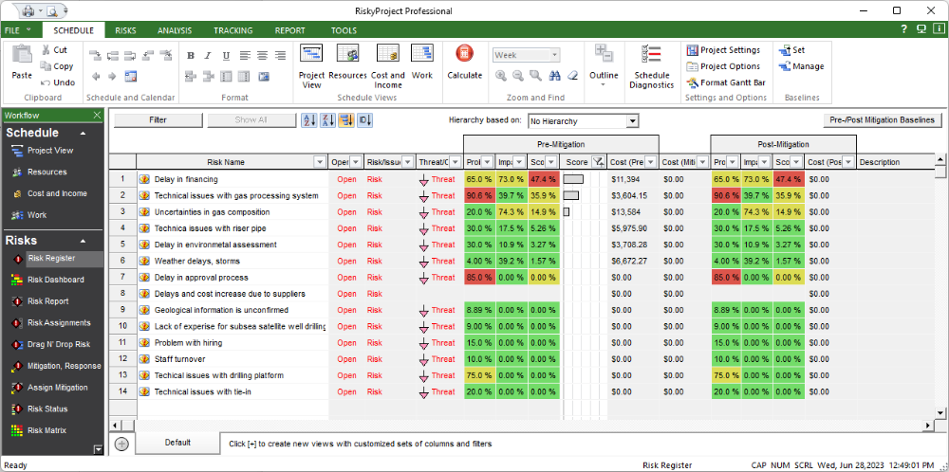
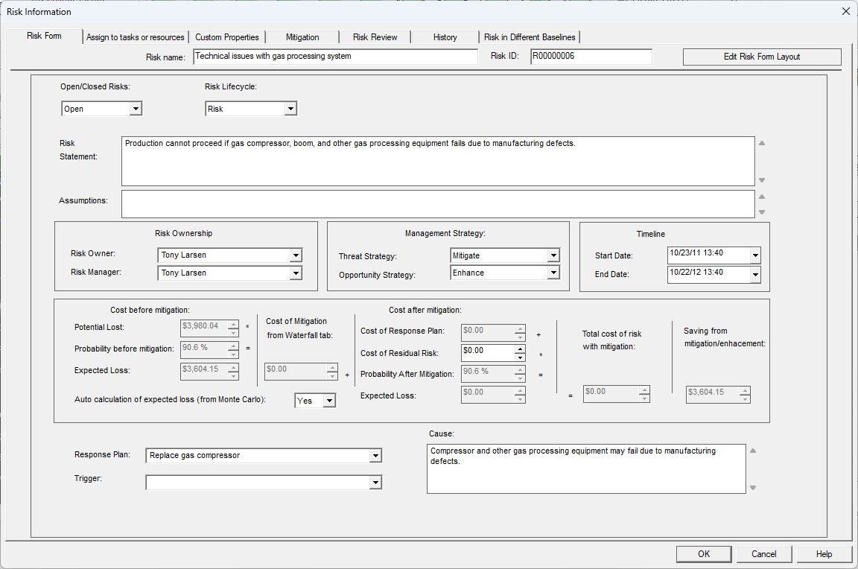
Corporate Risk Register
Risk Register include all information about risks: probabilities and impacts, properties, mitigation plans, etc.
Risks from Risk Register can be assigned to different projects, and within a project to different tasks and resources
Risk Properties Form – Input Risk Properties for each Risk
In RiskyProject Corporate Risk Register is shared among all groups and divisions of the company. One risk may affect different divisions.
Exploration
Production
Capital Projects
Public Relations
Finance
Strategic Planning
IT
……

Slide 21
Risk Attributes
Reviews
Cost
Mitigation and Response Plans
History
Risk attributes is information about risks
In project risk analysis they are separated on 7 groups
In other risk industries, the information can be different
Risk
Properties
Probabilities
Impact
Scores for Different Categories
Assignments to Tasks and Resources
Common
Custom
Dictionary of risk Properties

Slide 22
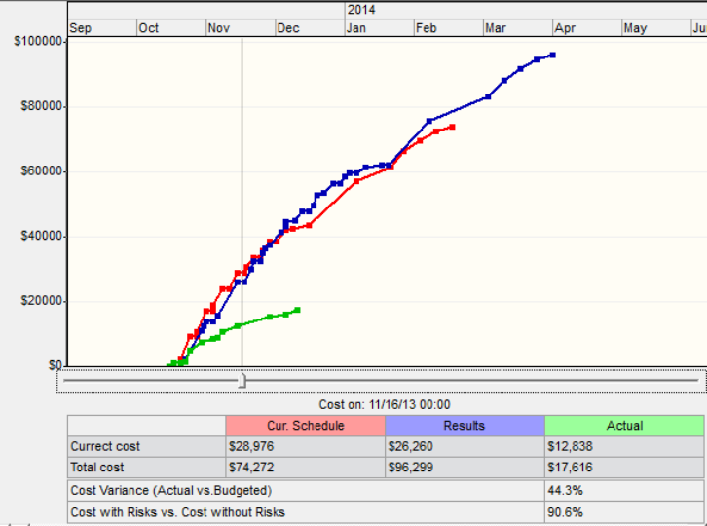
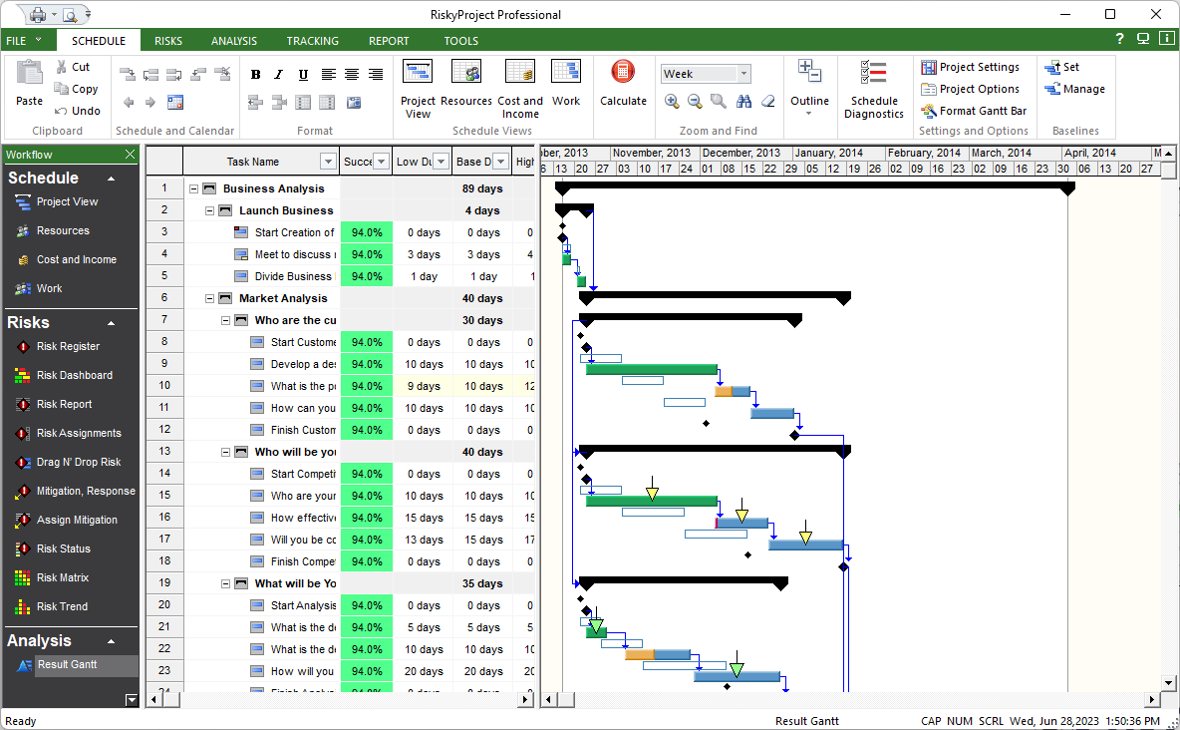
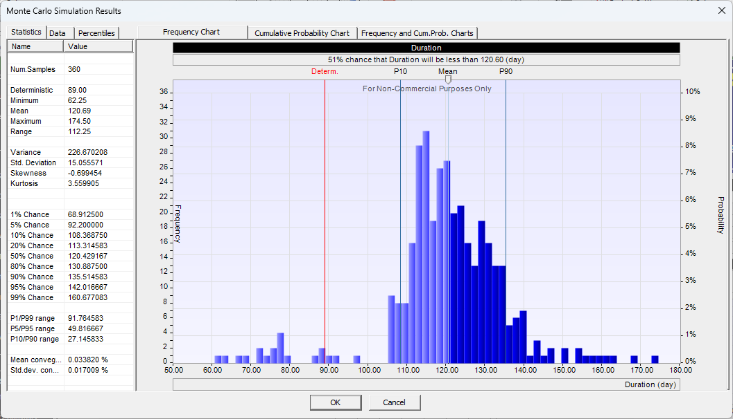
Monte Carlo Schedule and Cost Risk Analysis
Risk adjusted project schedules
Probabilistic Cost Analysis
Uncertainties in project duration, cost, start and finish times, work, etc.
Risk Register and uncertainties in task duration/cost serve as an input for risk analysis.

Slide 23
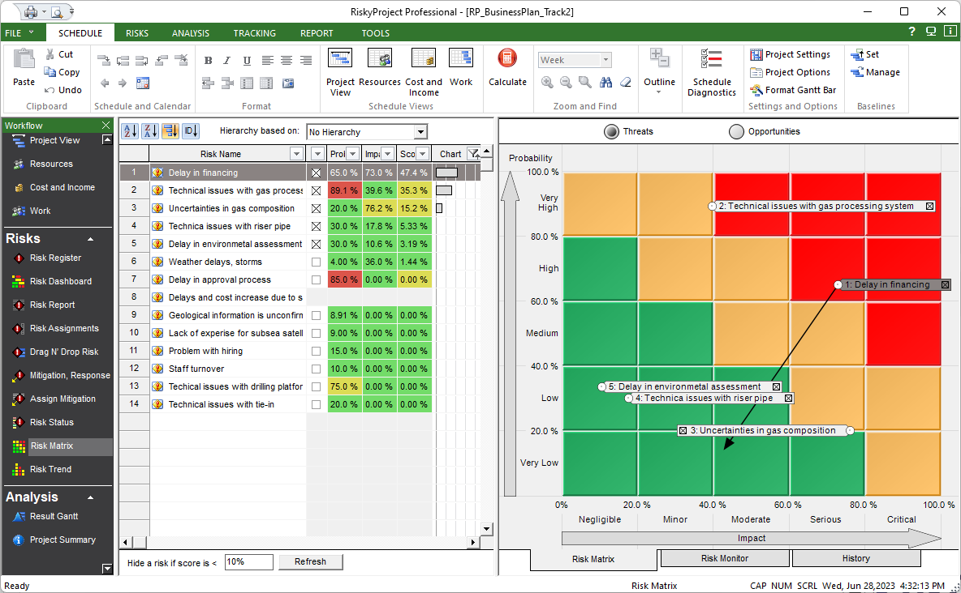
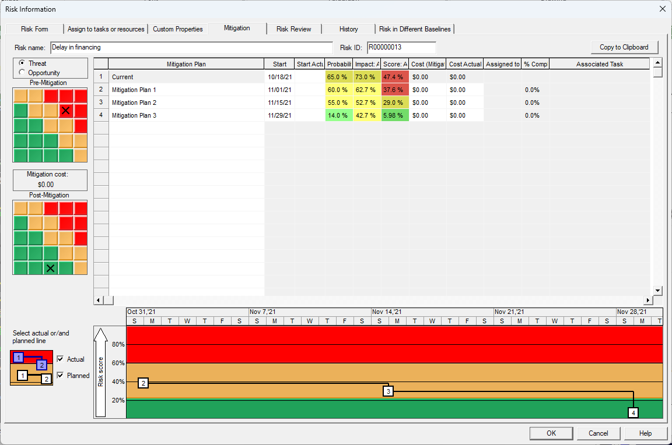
Qualitative Risk Analysis and Risk Mitigation
Risk Matrix and Risk Register
Mitigation Plans assigned to the risk
In most cases mitigation is conducted using multiple steps
Qualitative risk analysis allows to manage risk lifecycle during all phases of projects from exploration to development and production

Slide 24
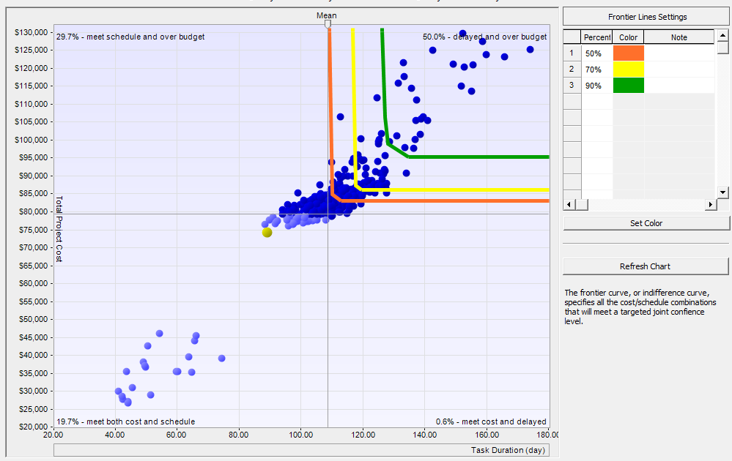
Joint Confidence Level Analysis

Slide 25
Risk Mitigation and Risk Response
Mitigation: Before risk occurred
Response: After risk occurred
Risk still may exist after response. It is called residual risks
Mitigation Strategies for Threats:
Avoid (Zero Risk)
Mitigated (Reduce)
Transfer (e.g. buy insurance)
Accept (ignore)
In project risk management Mitigation and Responses are small schedules which will be executed to reduce probability and impacts of risks
Mitigation Strategies for Opportunities:
Exploit
Enhance
Share
Accept (ignore)

Slide 26
Multi Criteria Decision Analysis
Multiple-criteria decision analysis (MCDA) explicitly evaluates multiple conflicting criteria in decision making
Methods of MCDA:
Weighted sum model
Value analysis
Multi attribute utility theory
Analytic hierarchy process
Goal programming
Rough set
Outranking
…..
Criteria, Objectives, Categories
For Project Risk Analysis:
Schedule related (duration, start and finish times)
Cost
Safety
Security
Environment
Technology
Quality
Litigation
…..
Essentially all methods are expert judgement elicitation techniques: ask expert for the judgement and ensure that judgement is accurate.

Slide 27

Contract Intaver Institute
sales@intaver.com
https://www.Intaver.com

