Slide 1
Event Chain Methodology
Schedule risk analysis technique that focuses on managing risk events affecting project schedules and relationship between them
Notes:
In this video we will learn about the basic principles of Event Chain Methodology. Event Chain Methodology is a schedule risk analysis technique. It focuses on managing risk events affecting project schedules and the relationship between them. Here is how it works.

Slide 2
Original Project Schedule
Risk Adjusted Project Schedule
Project slips due to the risks and uncertainties
Notes:
You created a very nice project schedule and start managing the project. However, in reality, the actual project schedule very often can be significantly different regardless of how well you prepared your original schedule. Many tasks can take longer or have a higher cost, some new tasks may be required, new resources can be introduced or something else can happen. All these changes are due to risk events, which you did not envision in your original schedule. Can we do something better? Can we prepare to ameliorate the original schedule?

Slide 3
Statistical Distribution of Task Durations
????
Notes:
One solution is schedule risk analysis. Schedule risk analysis usually involves assigning uncertainties to the original project schedule then executing Monte Carlo simulation. The result is the chance that your project will be completed on time and on budget. Uncertainties are modeled by statistical distributions. In most cases they are a defined three-point estimate of task’s duration and cost. For example: a task can take between 2 to 5 days and most likely 3 days. If you know the estimates for some or all tasks in the project, you can run Monte Carlo simulation and get the statistical distribution for the project duration or cost. This approach works well if you have precedence on how long it took to run such tasks before. If not, it will be what is called “garbage in – garage out”. When conjecture comes into the equation the estimates will be imprecise.

Slide 4
Risks Affecting Project Schedule
Risk
Probability
Impact
Score
Person left a project team
Some materials did not arrive on time
Bad weather
…..
…..
…..
…..
Notes:
Can we improve accuracy of the analysis? Yes we can. To do it we need to ask ourselves what is behind task uncertainties. In most cases these are risk events: something happened and made an impact on the project: persons left a project team, some materials did not arrive on time or the weather has changed. These events or risk drivers are easier to identify by asking the question: “what may happen?”

Slide 5
Risks Evens are Related to Each Other
Event 1
Event 2
Event 3
Notes:
However these events don’t occur by themselves. Most events are related to each other and form event chains. By analyzing these events it is possible to significantly improve the accuracy of project scheduling.

Slide 6
Principle 1: Single Events
Statistical distribution for moment of event
Event 1
Event 2
Ground State
Excited State 1
Excited State 2
Excitation
Notes:
Event Chain Methodology is based on six major principles. The first principle deals with a single event. According to Event Chain Methodology, events occur sometime during the middle of the activity and this changes the status of the activity.
The original state is called a ground state; other states are called excited states. For example, if the team completes their job, they can move on to another activity. State notion is important because certain events can or cannot occur when the activity is in a certain state. It means that the state of an activity is subscribed to the event.
Actual moment of an event is probabilistic. Most events can occur with a certain probability any time during the course of that activity. It is important to know the moment of a schedule risk event, potentially causing a restart of the activity or launching another activity.
Events can be local, affecting a particular task or global affecting all tasks.

Slide 7
Principle 2: Event Chains
Event Chain
Event 1
Event 2
Event 3
Notes:
The second principle of Event Chain Methodology deals with event chains. Events cause other events that create event chains. This knock-on effect has various dynamic relationships between events.
One event can trigger one or multiple events.
Events can be correlated with each other without one triggering another one. In this case if one risk has occurred, another one will occur and vice versa.
One event assigned in one activity can execute another activity or group of activities. In many cases it triggers a risk response plan. For example, the event is: “a structural defect is discovered”. This can cause one or more activities such as: “Repair”. Events can cause other events to occur either immediately or with a delay. The delay is a property of the event subscription. The delay can be deterministic, but in most cases, it is probabilistic.
Also, risks can be transferred from one activity to another.

Slide 8
Event Chain: Event 1 triggered a response event after some time
Event
Structural defect is discovered
Event: Execute Response Plan
Risk Response Is completed
Entry point
Risk Response Plan “Repair”
Exit Point
Execution of
Response Plan
Notes:
One event assigned in one activity can execute another activity or group of activities. In many cases it triggers a risk response plan. For example, the event is: “a structural defect is discovered”. This can cause one or more activities such as: “Repair”. Events can cause other events to occur either immediately or with a delay. The delay is a property of the event subscription. The delay can be deterministic, but in most cases, it is probabilistic.

Slide 9
Risk Transfer
Event 1
Event 1
Transferred
Notes:
Also, risks can be transferred from one activity to another.

Slide 10
Principle 3: Event Chain Diagrams
Closed or transferred risk
Closed issue
Issue
Threat
Opportunity
State: New Requirements
Notes:
The third principle defines rules for visualization of the events or event chains using event chain diagrams. Here are a few important rules:
Event chain diagrams present events as arrows on the Gantt charts.
Arrow pointing down is a threat. Arrow pointing up is an opportunity.
Issues are shown as an arrow in the circle.
Closed or transferred risks are shown using dashed lines. The color of the arrow is white. A closed issue is shown in the circle with dashed borderlines.
Excited states are represented by elevating the associated section of the bar on the Gantt chart.

Slide 11
Risk Probability and Impacts
Low impact
High probability and impact
Notes:
Colors represent the calculated impact of the risk. A higher impact is red or. A low impact is green. The size of the arrow represents probability.

Slide 12
Event Chains on Event Chain Diagrams
Event Chain
Event 1
Event 2
0.5
Event 4
Notes:
Event chains are shown as lines connecting arrows depicting events.
Event chains may trigger another activity. In this case, the event chain line will be connected at the beginning of the activity with an optional arrow.

Slide 13
Event Chain Executes an Activity
Event 1
Event Chain:
Event triggers activity
Notes:
Event chains may trigger another activity. In this case, the event chain line will be connected at the beginning of the activity with an optional arrow.

Slide 14
Event Chain Executes a Group Activities
Event 1
Event Chain:
Event triggers group of activities
Notes:
Event chains may trigger a group of activities. In this case, this group of activities will be surrounded by the box or frame and the event chain line will be connected to the corner of the box or first activity within a frame.

Slide 15
State Table
Task: Software Development
Event 2:
Problem with
development
tool
Event 1:
Architectural
changes
Event 3:
Minor
requirement change
Probability: 20%
Moment of event: any time
Excited state: refactoring
Impact: delay 2 weeks
Probability: 10%
Moment of event: any time
Excited state: refactoring
Impact: delay 1 week
Ground State
Excited state:
refactoring
Probability: 10%
Moment of event: start of the state
Excited state: minor code change
Impact: delay 2 days
Excited state:
minor code change
Notes:
Another tool that can be used to simplify the definition of events is a state table. Columns in the state table represent events; rows represent the states of an activity. Information for each event in each state includes four properties of the event subscription: probability, moment of event, excited state, and impact of the event.

Slide 16
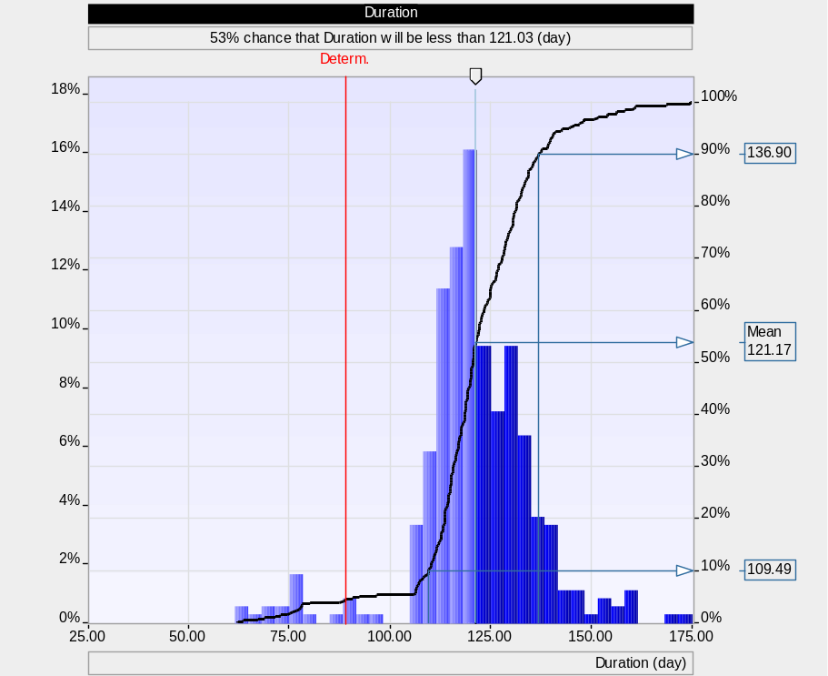
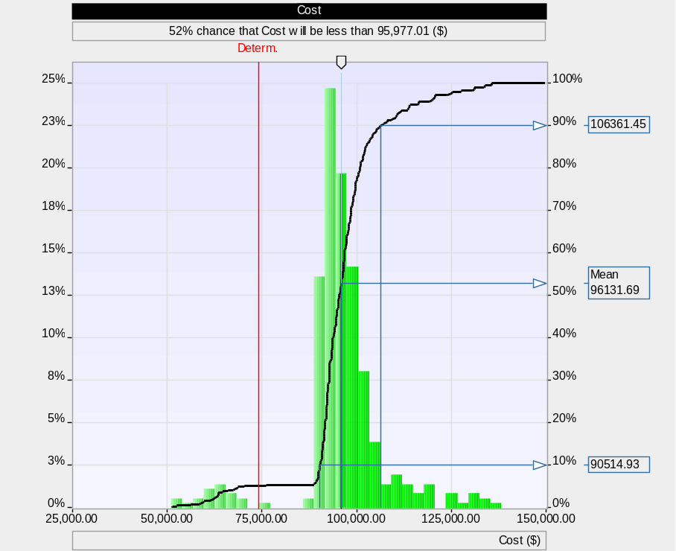
Principle 4: Monte Carlo Simulations
Notes:
The fourth principle deals with specific aspects of Monte Carlo simulation as part of Event Chain Methodology. From the scheduler’s point of view, Monte Carlo simulations for Event Chain Methodology is comparable with traditional Monte Carlo schedule risk analysis, however, the actual implementation of the Monte Carlo method on the software is different. The results of Monte Carlo simulation include statistical distribution of project duration and cost.
In Event Chain Methodology risk can be not only schedule-related or affecting duration and cost, but also non-schedule affecting safety, security, performance, technology, quality, and other project objectives. In other words one event can belong to different categories. The result of this analysis would project risk exposure for different categories as well as integrated project risk scores for all categories. This integrated project risk score is calculated based on relative weights for each risk category.

Slide 17
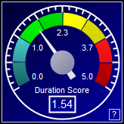
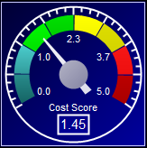
Schedule and Non-Schedule Risk Categories
Event 1
Impact:
Schedule – 20%
Cost – 30%
Performance – 50%
Quality – 45%
Litigation – 25%
Safety – 40%
Security – 30
Integrated Impact – 50%
Schedule related categories
Non-schedule
categories
Notes:
In Event Chain Methodology risk can be not only schedule-related or affecting duration and cost, but also non-schedule affecting safety, security, performance, technology, quality, and other project objectives. In other words one event can belong to different categories. The result of this analysis would project risk exposure for different categories as well as integrated project risk scores for all categories. This integrated project risk score is calculated based on relative weights for each risk category.

Slide 18
Principle 5: Critical Event Chains
Critical Event Chain
Notes:
The fifth principle deals with the analysis of the schedule with event chains. Events and event chains can be ranked based on the results of risk analysis. Critical threats with higher severity should be mitigated first. Event ranking is done by calculating the correlation between project results and instances of the events.
Event and event chain ranking is performed for all risk categories (schedule-related and non-schedule) as part of one process. Integrated risk probability, impact and score can be calculated using weights for each risk category.

Slide 19
Principle 6: Project control with events
Low estimate of project duration
High estimate of project duration
100%
% Complete
Project Duration
Notes:
Finally, the sixth principle deals with project control, with events and event chains. If the project is partially completed, the original set of risk events and their properties will change, mitigation and response plans will be executed. In most cases probability and impact of risks will be reduced as the project progresses. It would mean that the project uncertainties would reduce as well. Event Chain Methodology calculates reduced risk probability and impact automatically based on the percentage of work completed.

Slide 20
Risks
Risk response increases a chance of the project meeting the deadline
Chance of project meeting a deadline
(Project Success Rate)
100%
80%
60%
Chance of meeting the deadline is reduced as a result of events
40%
Risk response plan
20%
0%
0
2
4
6
8
10
12
Project Duration, Weeks
Notes:
We can monitor and illustrate your project’s probability of meeting a specific deadline. This variable is constantly updated as a result of Monte Carlo analysis.

Slide 21

Project Risk Analysis Made Ridiculously Simple
A Step by Step Guide to Project Risk Analysis
by Lev Virine and Michael Trumper
Hardcover: 284 pages
Publisher: World Scientific Publishing Co (March 5, 2017)
Language: English
ISBN-10: 9814759376
ISBN-13: 978-9814759373
Web site: www.projectdecisions.org
Notes:
If you need more information about Event Chain Methodology please read our book “Project Risk Analysis Made Ridiculously Simple”

