Slide 1

Intaver Institute Inc.
How to Analyze Risks in Construction Projects
Lessons Learned from Construction Industry
Project Risk Analysis and Risk Management

Slide 2
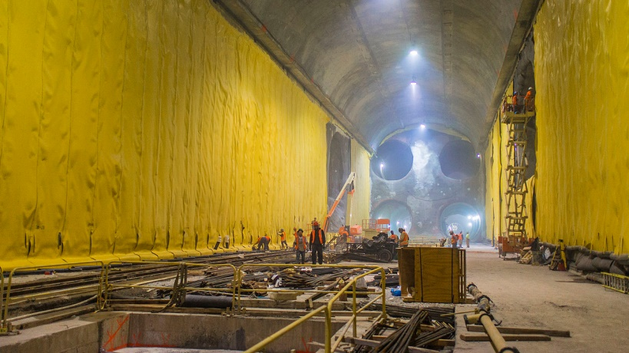
Construction Risks
1999 - $4.3B
2003 - $5.3B
2008 - $7.2B
2012 - $8.4B
2018 - $11.1B
Main Risks in Construction Industry
Design Changes
Poor Management
Weather
Delays Due to Supplier or Subcontractor
East Side Access Project, New York
The most expensive construction project of its type in the world
Project Risk Analysis and Risk Management
RiskyProject Software Suite
Notes:
Many construction projects are completed behind schedule or over budget and these overruns can be very significant. The East Side Access project in New York City is a very good example of this. The goals of this project is to extend the Long Island Rail Road from Queens into a new station under Grand Central Terminal in Manhattan. The project's estimated cost has escalated from $$4.3 billion in 1999, $5.3 billion in 2003, $7.2 billion in 2008, $8.4 billion in 2012. As of April 2018, the project is expected to cost $11.1 billion, almost triple the original estimate and making it the most expensive construction project of its type in the world.
The reasons for the ballooning costs were due to a number of factors including poor management, lack of oversight, as well as fraud.
Other critical risks in construction industry are design changes, weather delays as well as execution delays due to suppliers and subcontractors.

Slide 3
Why Construction Projects Are Often Behind Schedule or Over Budget
Deception: intentional attempt of project planners to underestimate cost and duration of project to get it approved
Delays and Cost Overruns
Poor project planning behind delays and cost overruns
Total Delay / Cost Overruns
Solution: project risk analysis
Delusion: unintentional planning mistakes due cognitive biases
Project Size
Project Risk Analysis and Risk Management
RiskyProject Software Suite
Notes:
Poor project planning is often behind delays and cost overruns and can be a result of delusions or the unintentional mistakes of project planners due to motivational biases. These types of mistakes are most prevalent in smaller projects. For example, due to optimism bias, planners often think that a project has much less risk and can be completed faster and at a lower cost..
In large projects, the source of cost and schedules overruns are often due to deception, or the intentional attempt of project planners or sponsors to create plans that have a reduced cost and duration with the goal of getting the project approved. This deception is often expressed as unrealistic reductions in the probability and impact of some risks and ignoring others.
One of the solutions to reduce the negative impact of these cognitive and motivational biases is project risk analysis.

Slide 4
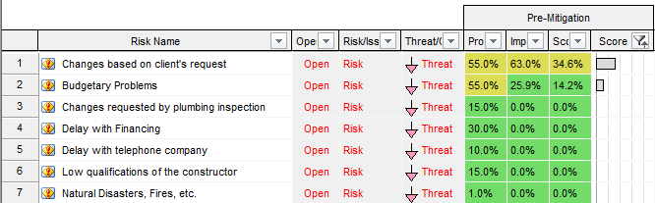
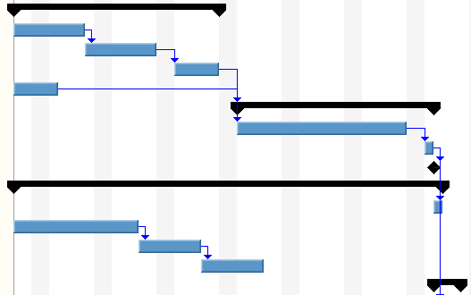

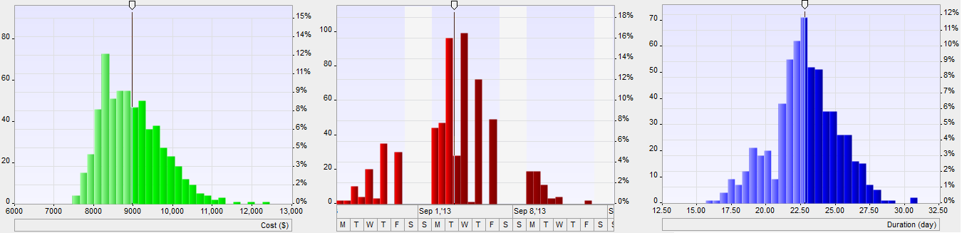
How Project Risk Analysis is Performed
Risk Register
Project Schedule
Assign risks
Run Monte Carlo simulations
Result of analysis
Project Risk Analysis and Risk Management
RiskyProject Software Suite
Notes:
To perform quantitative project risk analysis you need two sources of information: project schedule and risk register. Risks are assigned with probabilities and impacts to different activities in the schedule. Then Monte Carlo simulations are performed. Result are analysis statistical distribution of project cost, finish time and other project parameters as well as ranking risks in risk register.
Project risk analysis for construction schedules involve integrated analysis of project schedule and cost.

Slide 5
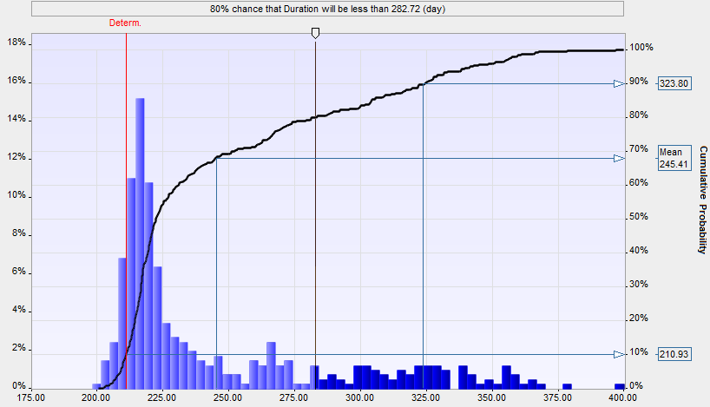
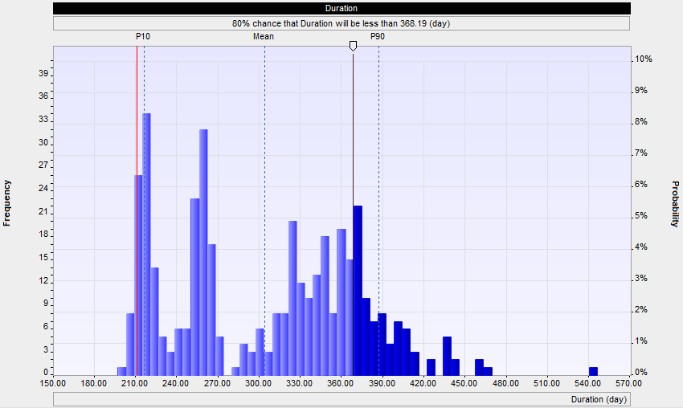
Project Risk Analysis for Competitive Bidding
Deterministic Duration –No Risks
80% confidence that project will be complete on time
Project Risk Analysis and Risk Management
RiskyProject Software Suite
Notes:
Accurate project risk analysis is critically important during competitor bidding. Construction companies should have certain of confidence level that they will complete the project within the schedule and budget. In this example, without risks, the project could be completed in 210 days. However, the p80 confidence level for completion is 282 days. So to meet the companies risk tolerance of p80, will require an additional 72 days of margin to account for risk.
Project owners are also seeing the value of project risk analysis as it gives them the opportunity to assess risk adjusted forecasts for project duration and costs prior the bidding process and allows them to verify the feasibility of bids.

Slide 6
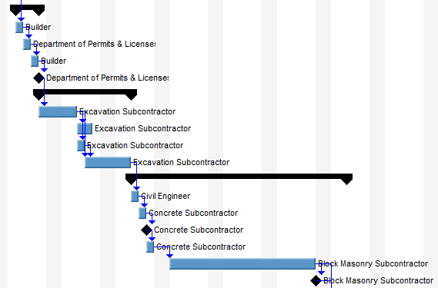
Risk Associated With Resources
Risk can assigned to resources
Increase/reduce
duration or/cost of tasks this resource is assigned to
rate
resource allocation
Project Risk Analysis and Risk Management
RiskyProject Software Suite
Notes:
When performing risk analysis, costs can also be analyzed by assigning risks to resources. For example, if one subcontractor is less productive or having quality issues, this will affect all tasks in which involve the subcontractor.
Resource risks impacts include duration, allocation, or resource rates all of which can impact both task duration and cost.

Slide 7
Criticality Index
Iteration 1
Iteration 2
Critical Path
Critical Path
Project Risk Analysis and Risk Management
RiskyProject Software Suite
Notes:
Most construction schedules include many parallel paths. For deterministic project schedules, critical path method identifies one critical path through the schedule. In Monte Carlo simulations, a critical path calculation is performed on each iteration. Because each iteration can model different task durations, the results of the simulation can produce multiple critical paths. The criticality index indicates the frequency at which a task is on the critical paths during the simulation. s called the. Tasks with a higher criticality index will most likely affect the final project finish time.

Slide 8
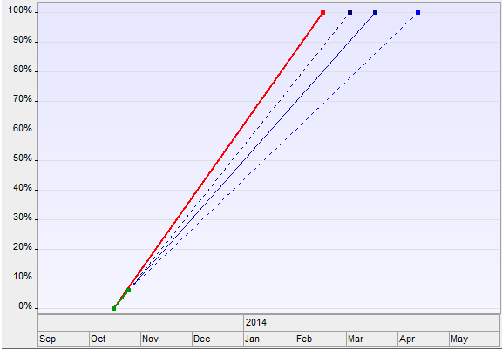
Project Control
Expected p80 project completion date with risks and uncertainties
Deterministic Schedule
High Estimate
Percent of project completed
Mean Estimate
Low estimate
Low estimate
Actual Duration of completed portion of project
Project Risk Analysis and Risk Management
RiskyProject Software Suite
Notes:
The control process is a critical part of project management process. Project risk analysis performed on each phase of the project helps to forecast project completion dates while accounting for risks and uncertainties as well as actual duration of the completed portion of a project.

Slide 9

About Project Risk Analysis
For more Information:
Project Risk Analysis Made Ridiculously Simple
A Step by Step Guide to Project Risk Analysis
by Lev Virine and Michael Trumper
www.intaver.com
Project Risk Analysis and Risk Management
RiskyProject Software Suite
Notes:
For more Information please read our book: Project Risk Analysis Made Ridiculously Simple. It is a Step by Step Guide to Project Risk Analysis. Please visit our website intaver.com or subscribe to our channel.

