Slide 1
Agile Project Management and Quantitative Risk Analysis
Intaver Institute Inc.
400, 7015, Macleod Trail,
Calgary, AB, Canada
Tel: +1 (403) 692-2252
www.intaver.com
Notes:
Agile has become the most popular project management process in the development and delivery of software systems as it has proven successful in managing the uncertainties in both technology and requirements that characterize software development.
The Agile Manifesto was first published in the early 2000s and has 12 principles. The focus is on frequent delivery of working software using processes that can quickly adapt to or accommodate changing requirements and environments. Agile delivers capabilities through the use of short iterative sprints with the goal of delivering working software on a continual basis.
While Agile mitigates much of the uncertainties caused by uncertainties and issues, for the delivery of large systems still requires development teams to estimate the time and cost it will take to deliver the required system capabilities. Using lists of issues with impacts that can affect both delivery dates and costs will allow Agile teams to develop realistic estimates for when specific capabilities can be delivered and also information that will improve decision making during the development process.
In this video, we will provide an overview of Agile teams can assign issues to their development plans and how this can provide simple insight into how this could impact their delivery dates and improve the quality of the team’s decisions.

Slide 2
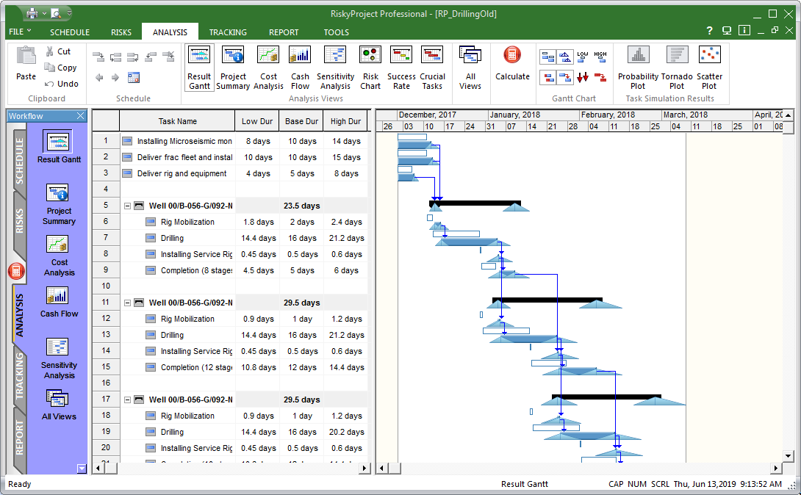
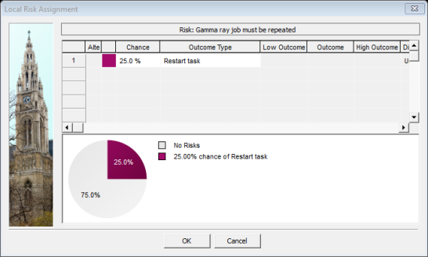
Conventional vs Agile Risk Analysis
Uncertainties
Risk Events
Forecast ranges for
Finish Times
Notes:
Before outlining how we can use risk analysis to improve project estimates and management, we will take a look at how Agile differs from conventional scheduling and how this affects schedule risk analysis. The goal of schedule risk analysis is to analyze the impacts of risk and uncertainty and develop plans that minimize the impact where possible and account for the unmanaged residual risks.
The analysis requires a project plan with activities with start and finish times linked in a precedent network.
Risks and uncertainties are assigned to the project plan
Uncertainties are assigned as 3 pt estimates (Low, Base, and High) with statistical distributions
Risks: events that have a probability and impacts to cost, schedule and performance.
Monte Carlo simulations produces ranges of probabilistic outcomes for tasks and projects based on these risks and uncertainties. Estimates to complete can the be made based on the risk tolerance of an organization. In this case the duration of particular activities is considered variable.
In comparison, though Agile projects are subject to similar risks and uncertainties, they use sprints which have a set length that never varies. Therefore estimating the time and cost to complete an Agile project with risks and uncertainties must use a different process.

Slide 3
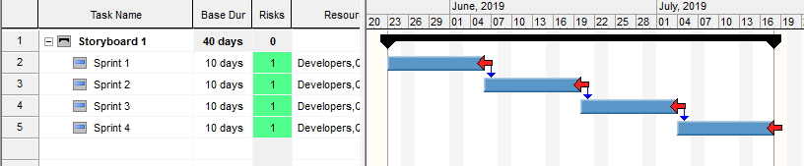
1. Create an Agile Plan
Storyboard with Sprints
Deadlines (Optional)
Notes:
Here we can see a sample of an Agile plan that will use 4 sprints to deliver a completed storyboard of capabilities. Each sprint lasts 2 weeks for a total of 8 weeks Each sprint is assigned resources (developers, QA, and Documentation). In addition, we can assign resources to each sprint as seen in the Resource column. Resources are useful for this analysis as some issues only impact specific resources. Adding deadlines on can be useful visual marker.

Slide 4
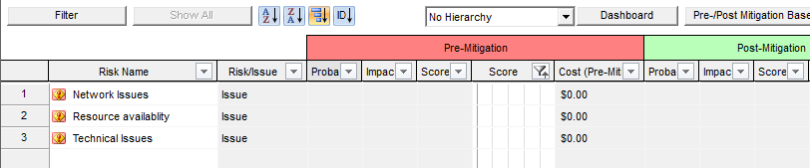
2. Add Issues
List of Issues
Notes:
The team can then identify known issues they believe will have significant impact on the successful delivery of the sprints.

Slide 5
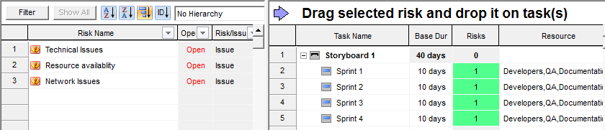
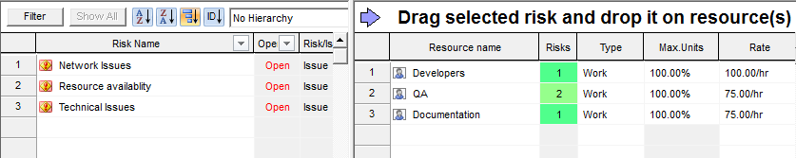
3. Assign Issues to Resources or Sprints
List of Issues
Assign to Sprints
Assign to Resources
Notes:
Issues can then be assigned to either specific resources or to the sprints.
In the first example both the QA and Documentation resources are shared with other projects and availability to the project is an issue.
In the second example, the team anticipates that there will be significant technical issues to resolve that may delay the delivery of specific requirements.
During project execution, issues can be added or closed as each sprint progresses.

Slide 6
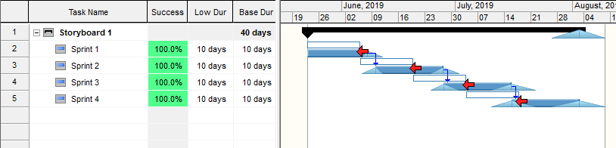
4. Run Simulation
Risk adjusted duration
Notes:
Once issues have been assigned a quick calculation is run to show how the issues might affect the planned work in each sprint. The results can be used to modify the development plan.

Slide 7
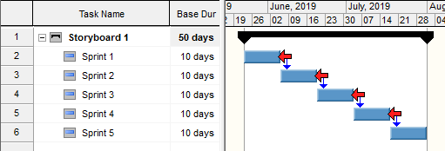
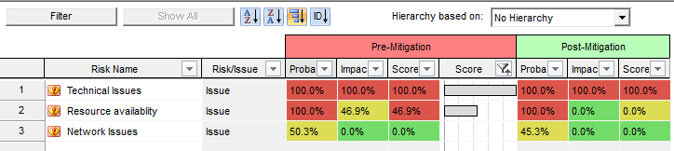
5. Adjust Plan
Option A: Add additional sprint
Option B: Minimize impact of issues
Notes:
In this case the team could consider to options the increase the chance capabilities will be delivered on time and within budget.
Option A is to add an additional sprint as the likelihood of delivering in 4 sprints is too low.
Option B is to minimize the impacts of issues. Examples might be to add additional resources or schedule additional time on a test server.

