Slide 1
Webinar: Risk Management for Oil and Gas Projects
Intaver Institute Inc.
303, 6707, Elbow Drive S.W, Calgary, AB, Canada
Tel: +1(403)692-2252
Fax: +1(403)459-4533
www.intaver.com

Slide 2
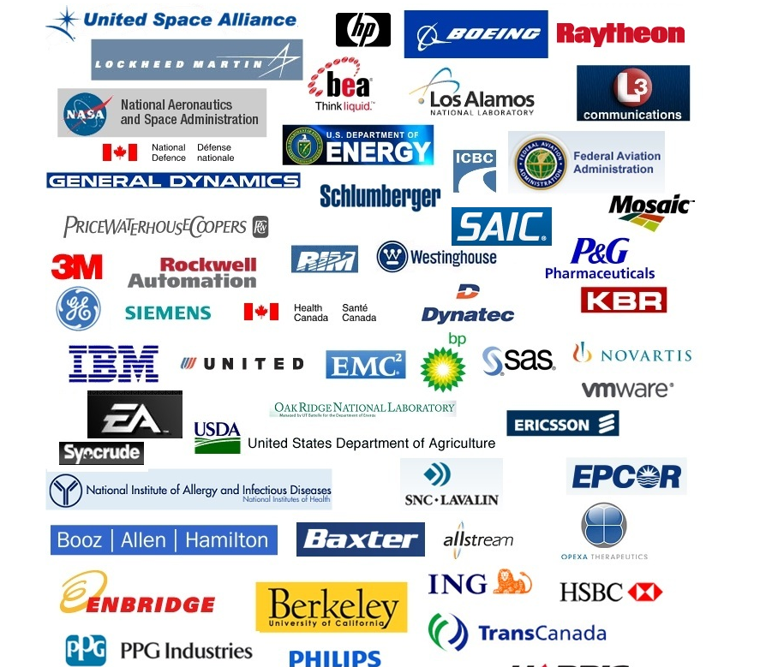
Introduction
Intaver Institute Timeline
  2002: Established
  2004: V.1 RiskyProject
  2009: v 3 Integrated Risk Register
  2012: v 5
RiskyProject
  Full Project Risk Management Lifecycle
  Integrated Risk Register
  Risk Matrix, Risk Planning
  +
  Quantitative Monte Carlo Cost and Schedule Risk Analysis
Clients

Slide 3
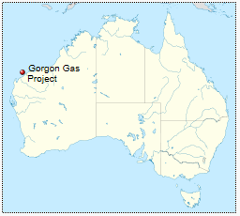
Gorgon Natural Gas Project
A three-train liquefied natural gas (LNG) facility on Barrow Island (Australia) that will produce 15.6 million metric tons of LNG per year.
Project Cost Estimate in Billions A$
Date of cost estimate

Slide 4
Project Risk Analysis in Portfolio Management Process
Project Cost and Schedule risks and uncertainties
Geological and other Uncertainties affecting production
Economic Analysis of the Projects
Corporate Portfolio Management
Strategic Decision
Price Uncertainties
Other Risks and Uncertainties:
Political risks
Uncertainties in Royalties regimes
….

Slide 5
Risk Management Affects Project Profitability
Full circle cost of gas
$/Mcf

Slide 6



Identifying and Managing Critical Risks is Key
Opportunity?
Risk
Threat?

Slide 7

Which risks are critical?
Risk 1
Risk 3
Risk 2
Risk 4
Risk 3
Risk 1
Risk 4
Risk 5
Risk 5
Risk 2
Schedule risk
Cost Risk
Safety Risk
Legal Risk
Quality Risk
Enviromental Risk
…………….. Risk

Slide 8


Time is Money: Cost and Schedule Risks
Schedule risk drives Costs due to time dependent resource costs
40% -70% cost risk is schedule driven
Schedule risk
Cost Risk
Time Dependent Costs

Slide 9
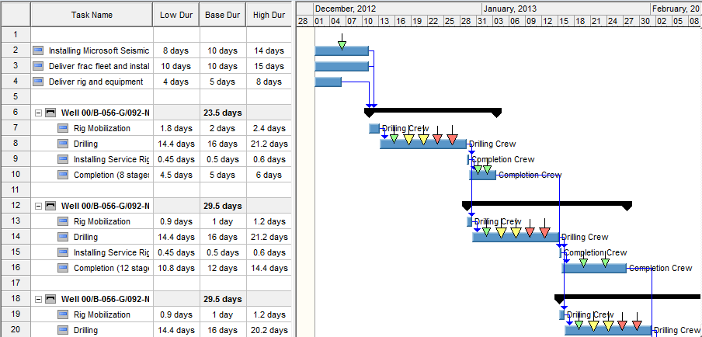
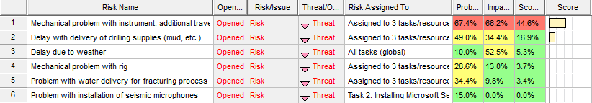
Risk Events Approach
Input 1: Project Schedule
Perform Analysis
Assign Risks to Project Tasks and Resources
Input 2: List of Risks (Risk Register)

Slide 10
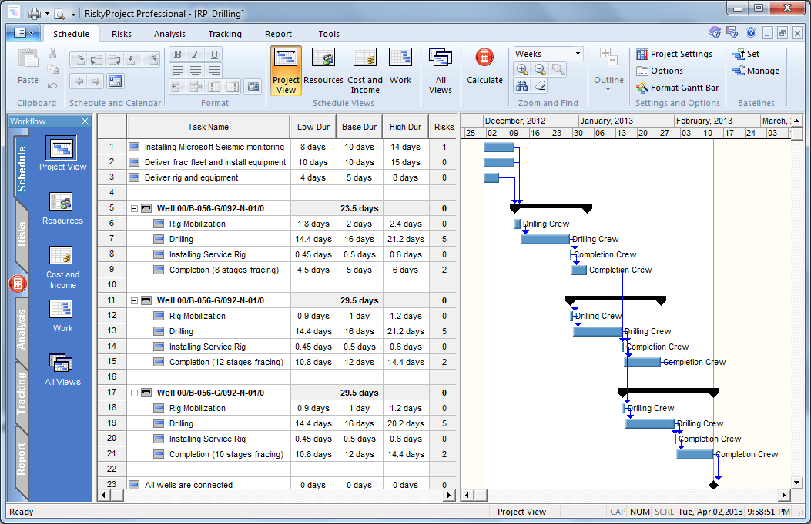
Schedule

Slide 11
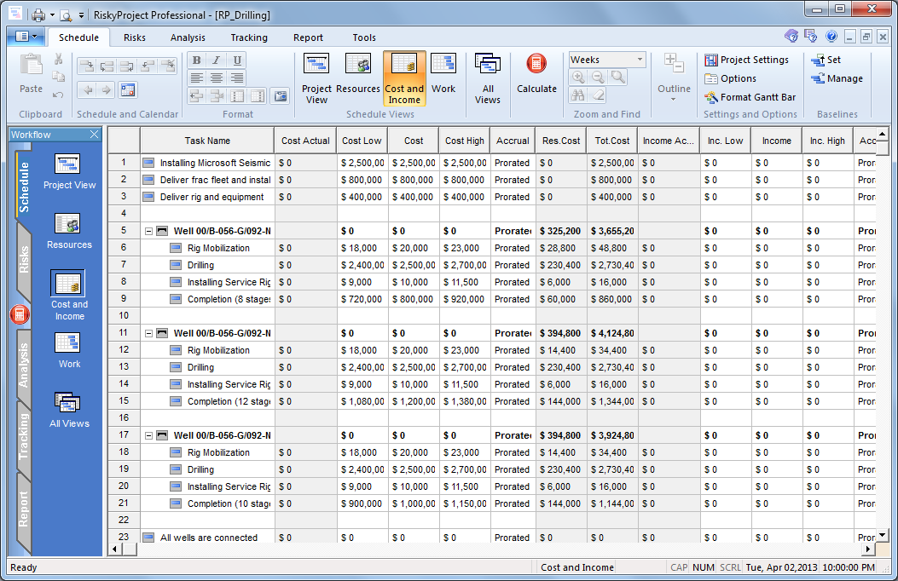
Costs

Slide 12
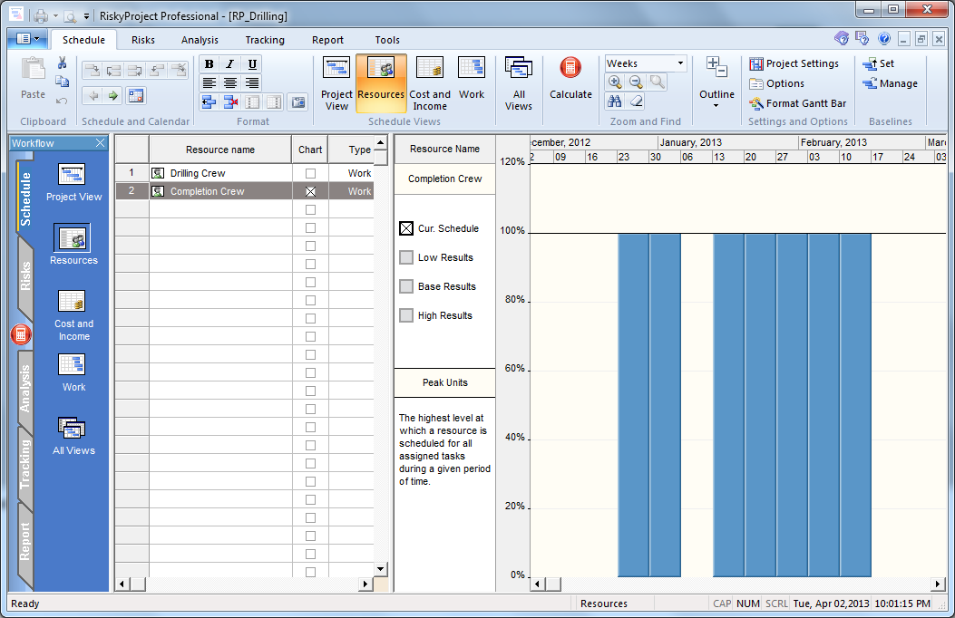
Resources
Notes:
To model schedule driven cost, we have included high level resources that have been assigned to specific tasks.

Slide 13
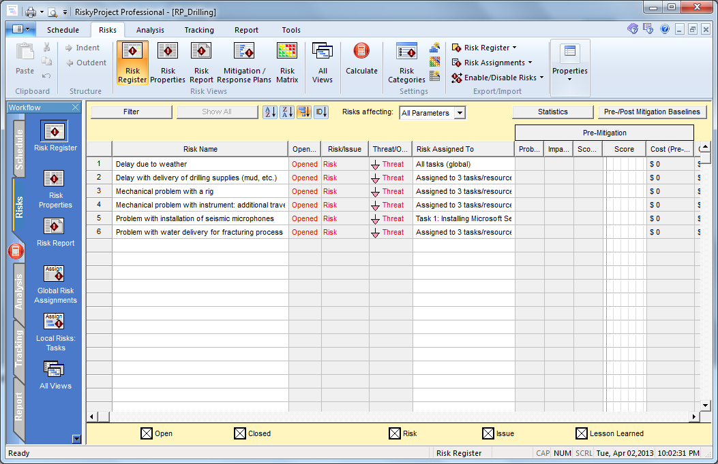
Risk Register

Slide 14
Risk Assignment
Task | R1 | R2 | R3 | R4 | R5 | R6
Installing Microsoft Seismic monitoring |  |  | x |  | x
Deliver frac fleet and install equipment |  |  |  |  | x
Deliver rig and equipment |  |  |  |  | x
Well 1,2,3 (share common risks) |  |  |  |  | x
Rig Mobilization |  |  |  |  | x
Drilling | x |  |  | x | x | x
Installing Service Rig |  |  |  |  | x
Completion (8 stages fracing) |  | x |  |  | x

Slide 15
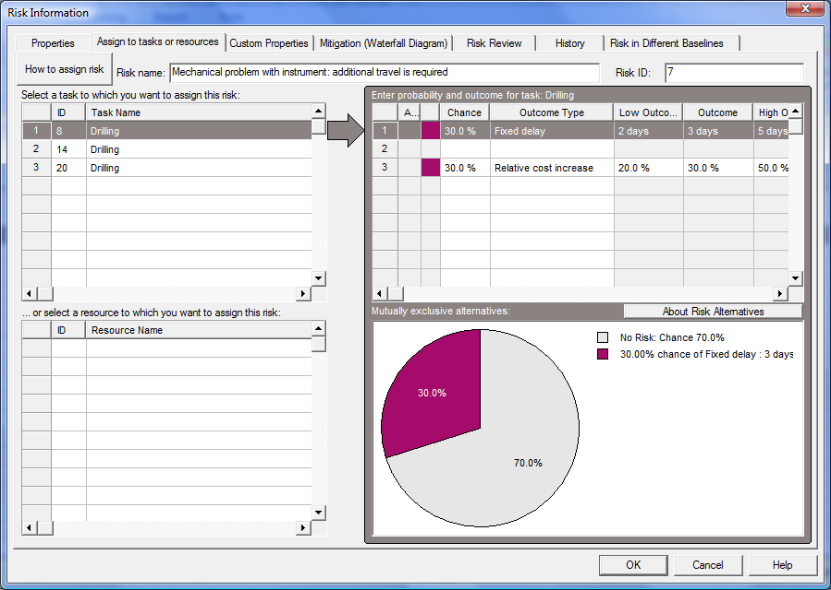
Risk Assignment Interface
30 % chance that risk causes a delay and increase in cost of drilling
Risk Assigned to task ‘Drilling’

Slide 16
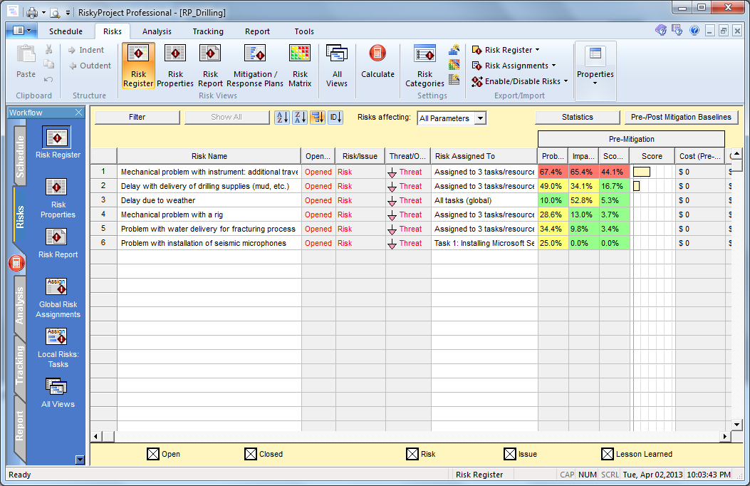
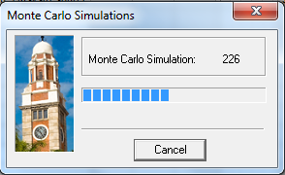
Run Monte Carlo Simulation

Slide 17
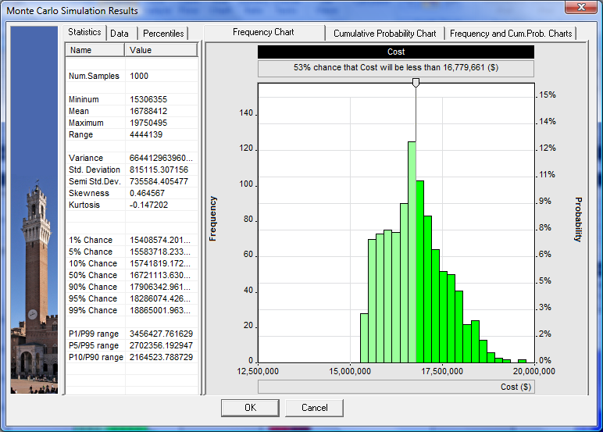
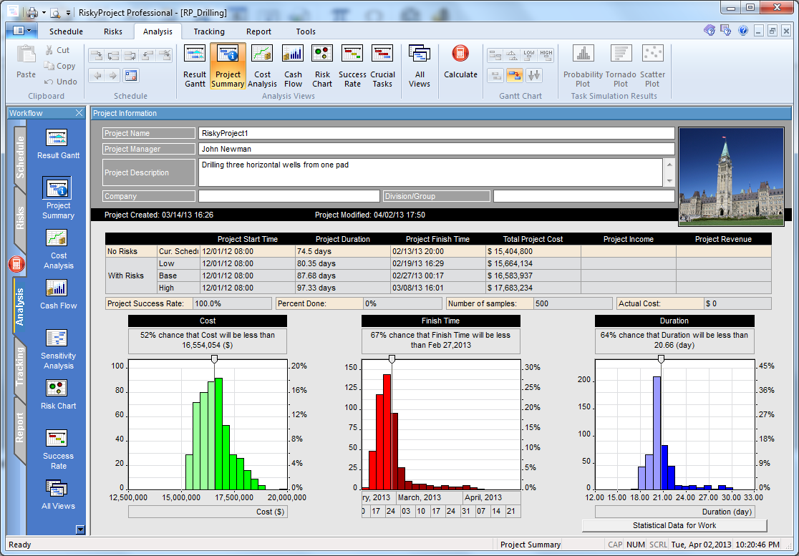
Results of Analysis

Slide 18
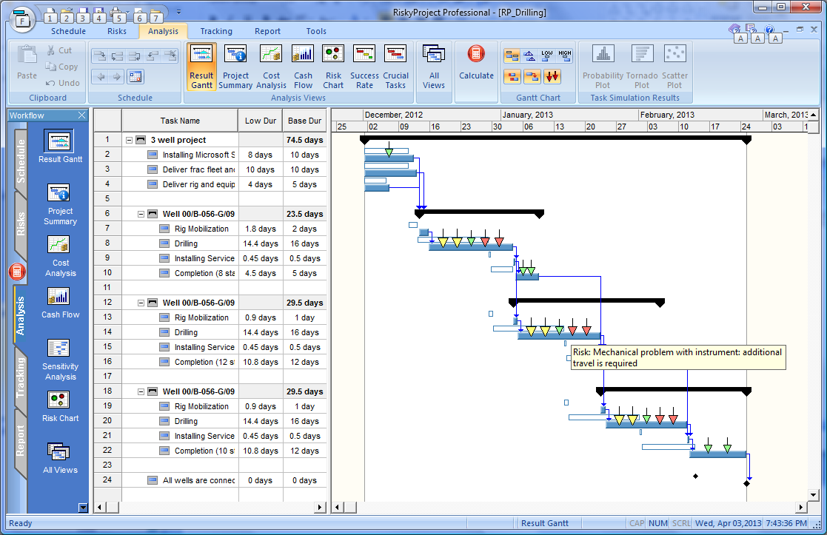
Risk Adjusted Project Schedule
Schedule with risks
Schedule without risks
Arrows show risk assignments

Slide 19
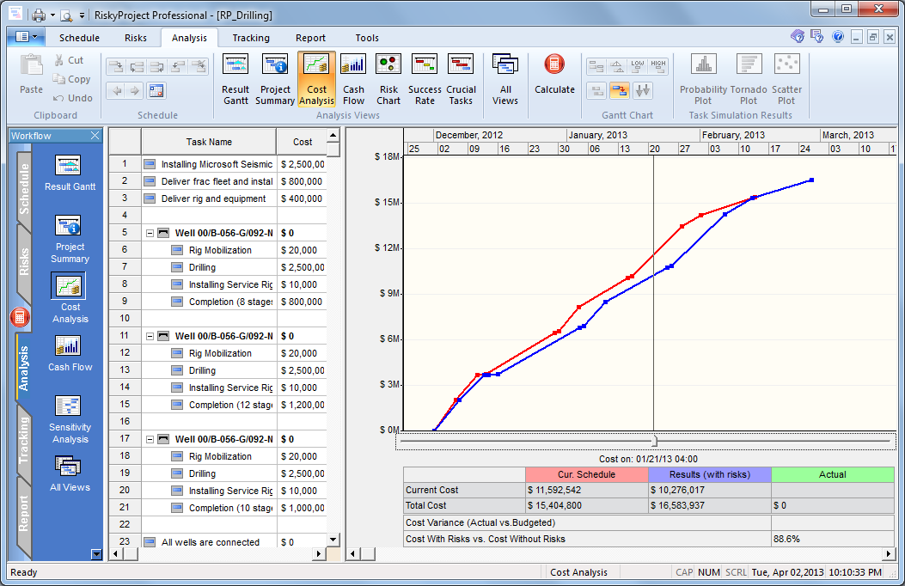
Project Cost
Schedule without risks
Schedule with risks

Slide 20
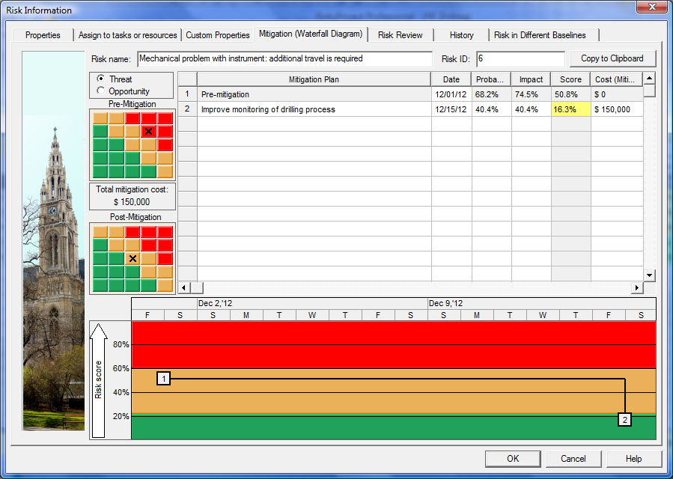
Risk Planning – Mitigation Plan

Slide 21
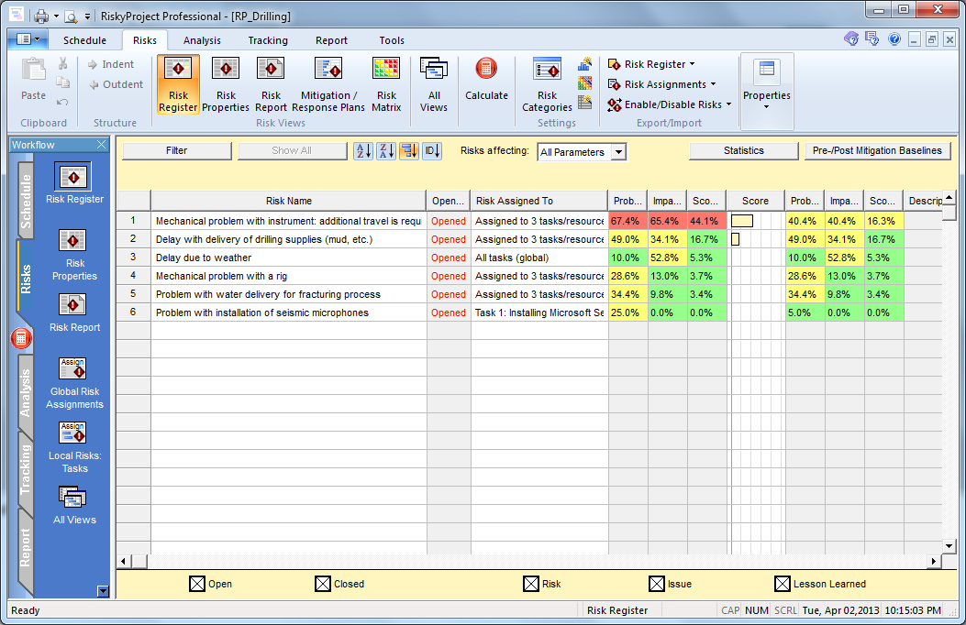
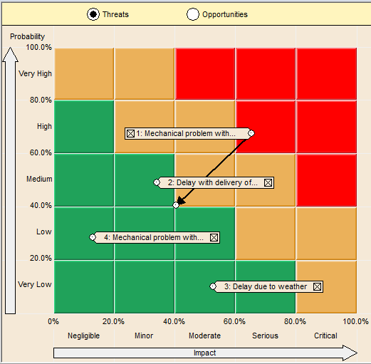
Pre and Post Mitigation
Pre-mitigation
Post-mitigation

Slide 22
Risk Planning
Risk: Mechanical Problem with instrument
Pre-Mitigation Cost 17, 178, 397
Post Mitigation $16, 734, 906

Slide 23
RiskyProject Enterprise
Enterprise Risk Database:
Schedules,
Risks,
Mitigation Plans
RiskyProject Professional
RiskyProject Lite
RiskyProject Risk Register

Slide 24



Future Reading
Project Think:
Why Good Managers Make Poor Project Choices
Project Decisions: The Art and Science
Introduction to Project Risk Management and Decision Analysis
Project Risk Analysis Made Ridiculously Simple

Slide 25
Future Reading
P. Leach. 2005. Late and Over Budget: Why Projects Always Seem to Take Longer and Cost More Than Planned. Projects & Profits, Vol. V Issue - XI, November 2005
http://www.project decisions.org
http://www.intaver.com/index-whitepapers.html
http://www.risk-doctor.com/
http://www.projectrisk.com
Contact
Michael Trumper
mtrumper@intaver.com
403.692.2252
Intaver Institute Inc.
www.intaver.com

